Slide 1
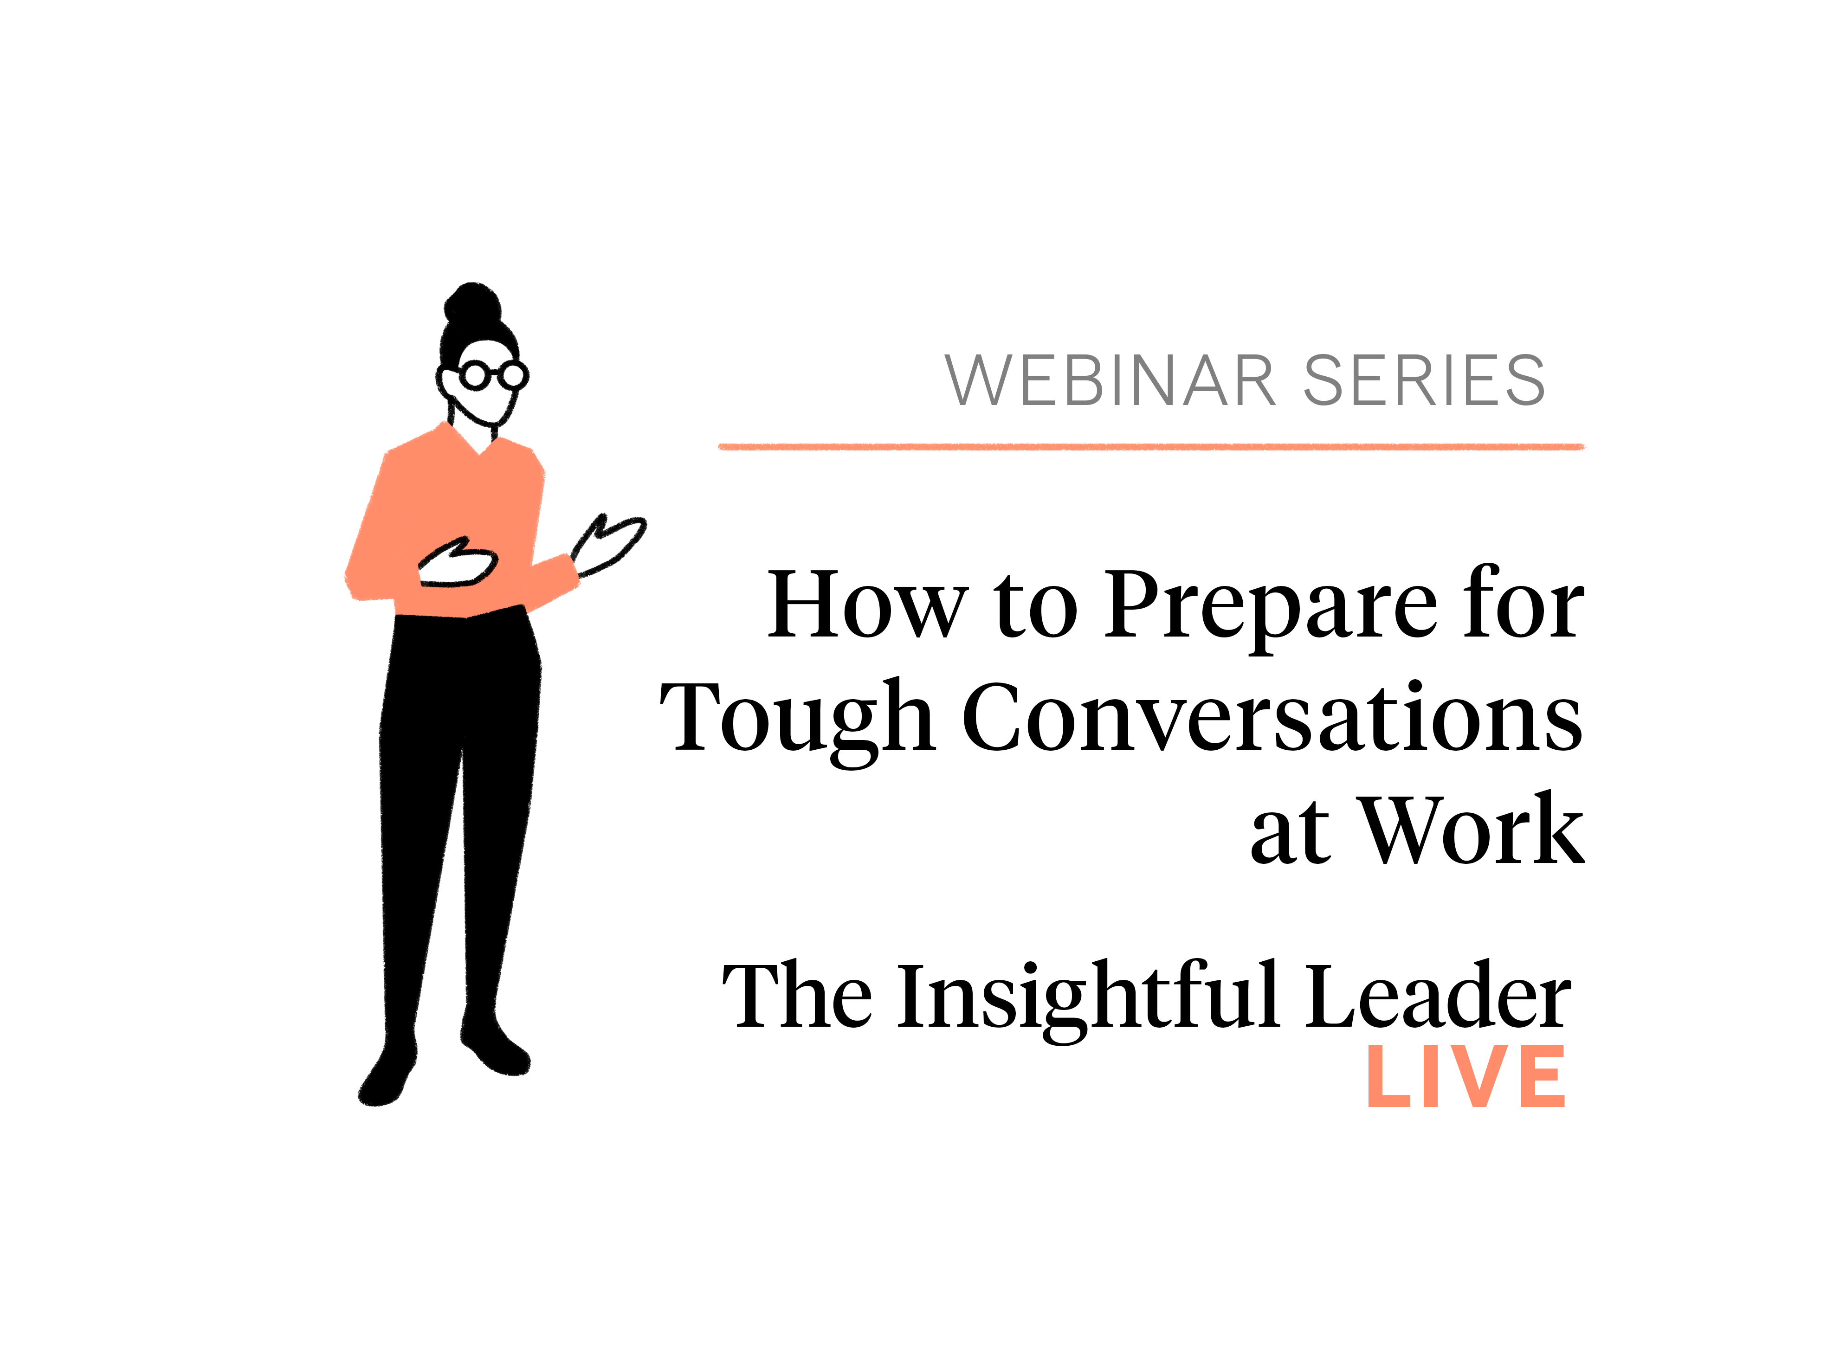

Slide 2
How to prepare for tough conversations at work--
Brooke Olson Vuckovic, PhD

Slide 3



Avoid or Delay
Message Technique
Practice Opening

Slide 4


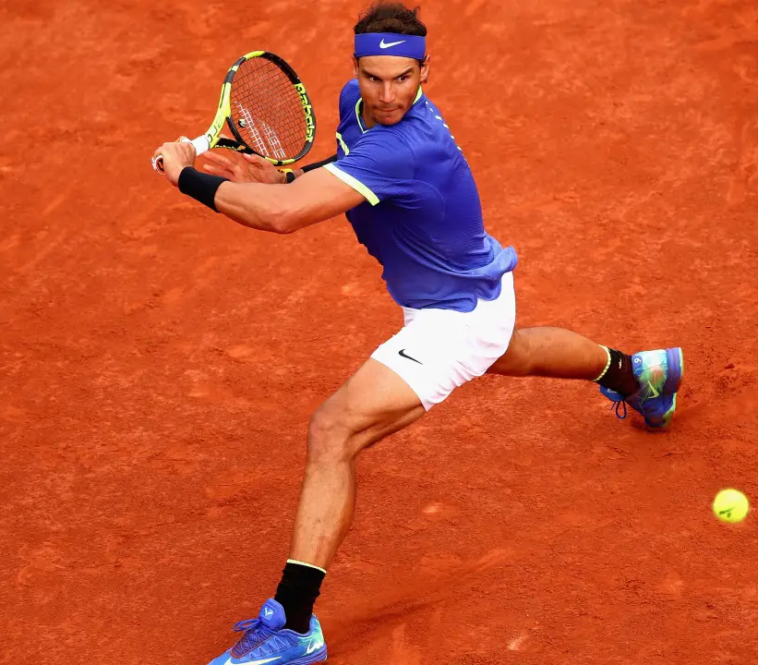
Clarify Purpose
Count on Contrast
Stay in the Game

Slide 5
Clarify Purpose
Big “P” Purpose
What do you want for you?
For the other party?
For the relationship?
For the organization or team?
For those you serve?
Small ”p” purpose: What do you hope to achieve from this very next conversation?

Slide 6
Count on Contrast
Reflect on your own contribution
Reframe your stories
Invite in perspectives
Be willing to be changed by what you hear.

Slide 7
Stay in the Game
Listen well
Maintain safety
Play to the end

Slide 9




Slide 10
Thanks for joining us.
For more of the latest faculty research and ideas visit:
Insight.Kellogg.northwestern.edu

