Slide 1
Communication in end-of-life care

Slide 2


Aims and objectives
To develop an understanding of the importance of communication in end-of-life care.
After completing this talk, you should be able to:
  Analyse the challenges to your shared decision-making and communication skills.
  Begin to identify your own capabilities in communicating with patients at the end of life.
  Identify phrases to adopt and adapt.
  Identify which End-of-Life Essentials modules to complete.

Slide 3

Key points to remember
Offering to discuss end-of-life issues will not cause harm to your patients.
Anxiety for patients and clinicians is normal when discussing end-of-life issues.
No matter your role or where you work, you can make a huge difference by giving patients and their families the chance to talk and prepare for the end of life.

Slide 4
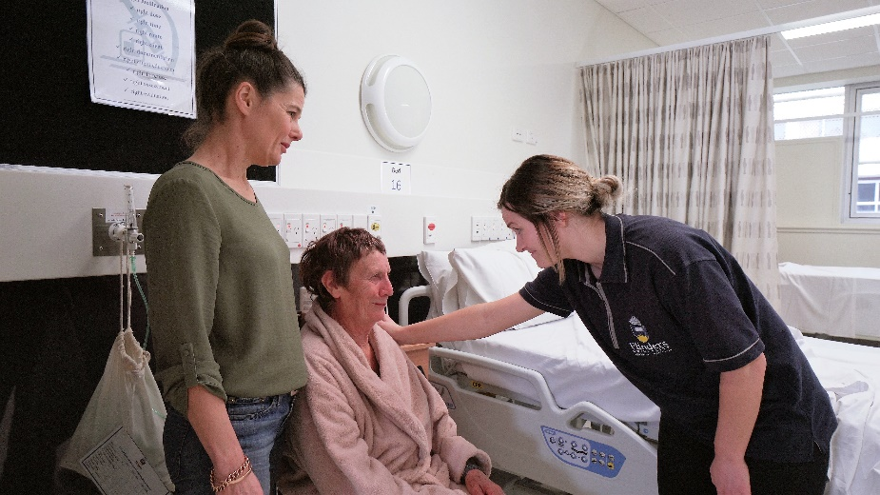
Patient-centred care
The following concepts define patient-centred care:¹
  Informing and involving patients and those important to them
  Eliciting and respecting patient preferences
  Engaging patients in the care process
  Treating patients with dignity
  Designing care processes to suit patient needs, not providers
  Ready access to health information
  Continuity of care.

Slide 5
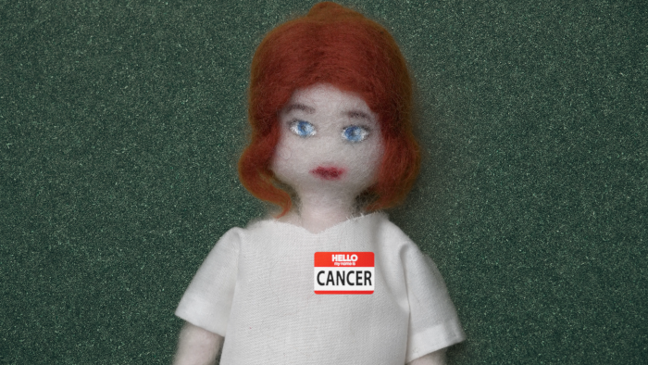

A patient’s point of view
CLICK THIS LINK
To watch ‘The Patient’s Perspective’ animation, featuring a person with cancer.
How often do you consider the patient as a person with a life, family, and vulnerabilities?

Slide 6
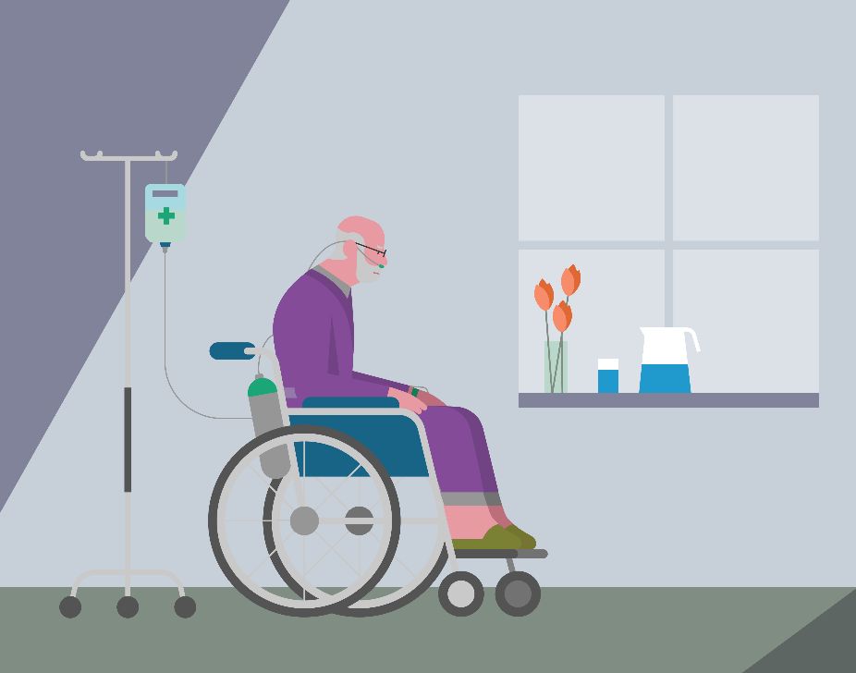
How do you know when to discuss end-of-life care?
The patient may directly ask you.
You may have updates from consultants and your team.
You’ve discussed with the team.
You’ve used a tool like the SPICT.^{2,3}

Slide 7
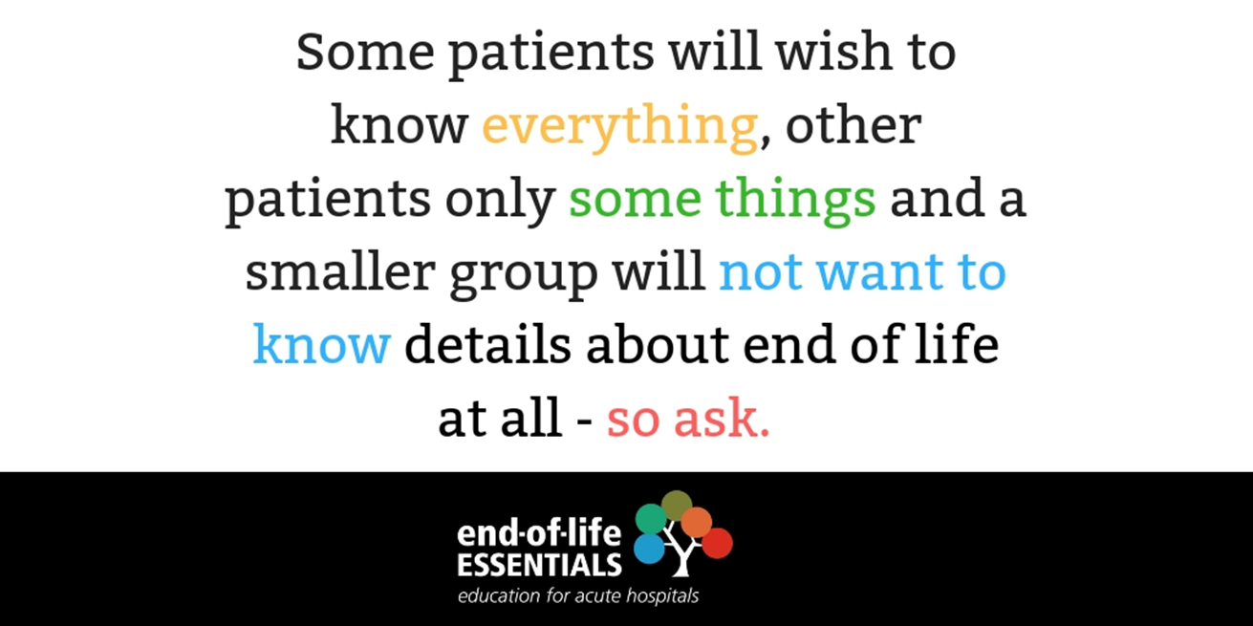

Slide 8

Tips for facilitating conversations with patients
Use plain language.
Offer repeated explanations as requested.
Show the patient that they have your full attention.
Invite the patient to have a support person with them.
Respect the patient’s need for privacy.
When speaking with the patient, be seated at a comfortable distance at the patient’s eye level.⁴

Slide 9
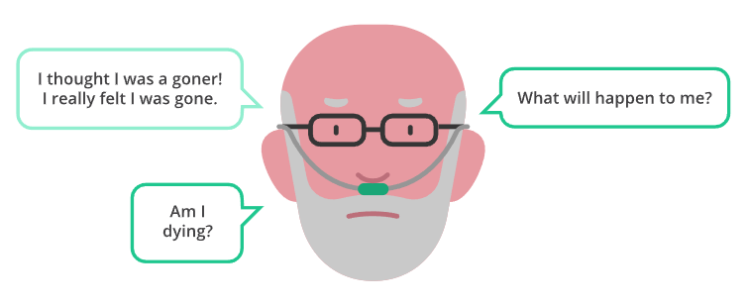
Be prepared
Unexpected questions or comments from patients and families are common…

Slide 10
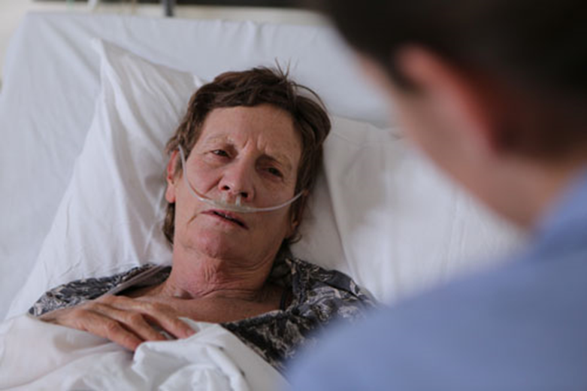
Case study: Joan
CLICK THIS LINK
To watch the film ‘I thought I was going to die’, featuring a patient, Joan.
Spend a few moments now and consider how you would respond to the patient in the film.
Be honest. How would you respond?
If you feel comfortable, share and discuss in a group.

Slide 11

Example questions for you to adopt and adapt
“What worries you most about your illness?”
“What are your most important [hopes/expectations] about the future?”
“As you think about the future and that you may not have a very long time to live, what is most important to you?”
“What are the things you most want to invest your time and energy in?”
“What are the things you want to do in the time you have?”
“Is there any particular event that you are looking forward to?”⁵

Slide 12
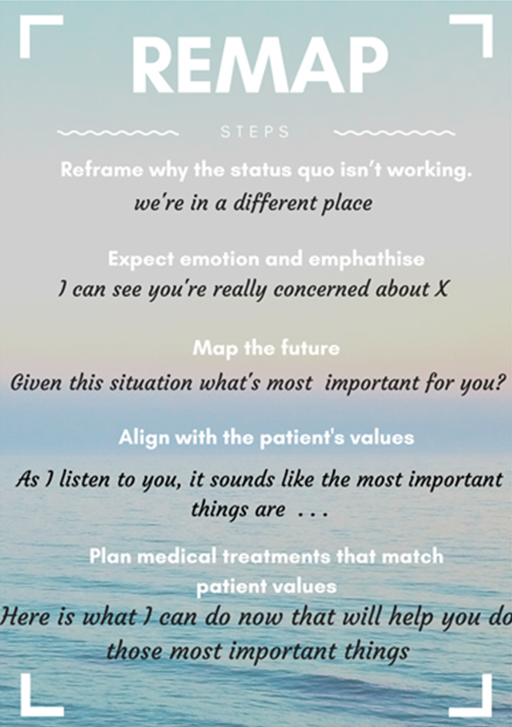
REMAP
It can help to use a tool like the REMAP framework⁶ when discussing end-of-life care with patients.
Adopted from VITAL talk REMAP

Slide 13
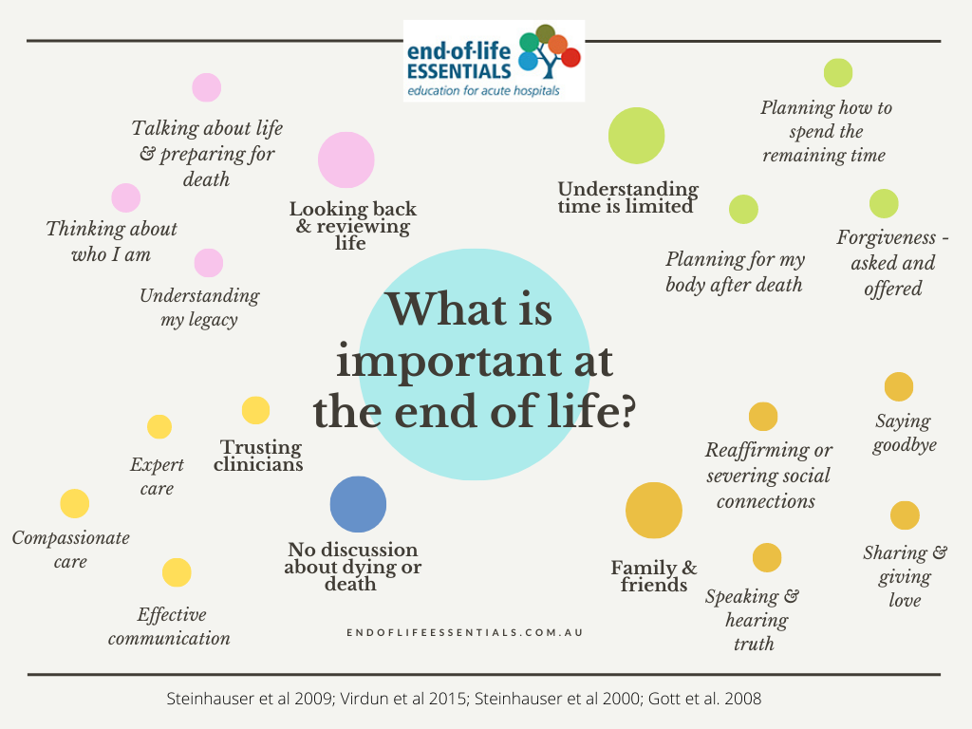

Slide 14
What is one aspect of your communication that you will develop further?

Slide 15

Self-care reminder
Providing care to dying patients can be stressful. It is important to evaluate your own health and emotions, practicing self-care when possible. Who and what are your supports within your workplace and more broadly?

Slide 16
Summary
You can make a huge difference by giving patients and families the chance to talk and prepare for the end of life.
You can prepare for unexpected but common questions from patients and families, such as ’What will happen to me?’ ’Is this the end?’
Resources are available for you to extend your practice by adapting and adopting end-of-life care skills.
End-of-Life Essentials advocates proactive approaches to professionals' quality of mental health.

Slide 17




Which modules should I complete next?
Teams and Continuity for the Patient
Goals of Care at the End of Life
Bereavement Care

Slide 18
References
  Janerka C, Leslie GD, Gill FJ. Development of patient-centred care in acute hospital settings: A meta-narrative review. Int J Nurs Stud. 2023 Apr;140:104465. doi: 10.1016/j.ijnurstu.2023.10446
  Australian Commission on Safety and Quality in Health Care. Safety and quality of end-of-life care in acute hospitals: a background paper. 2013. Available from: www.safetyandquality.gov.au/publications-and-resources/resource-library/safety-and-quality-end-life-care-acute-hospitals-background-paper
  Australian Commission on Safety and Quality in Health Care (ACSQHC). Delivering and supporting comprehensive end-of-life care: a user guide. 2021. Available from: www.safetyandquality.gov.au/publications-and-resources/resource-library/delivering-and-supporting-comprehensive-end-life-care-user-guide
  Australian Commission on Safety and Quality in Health Care (ACSQHC). Implementing the Comprehensive Care Standard: Identifying goals of care. 2019. Available from: www.safetyandquality.gov.au/sites/default/files/2019-06/implementing-the-comprehensive-care-standard-identifying-goals-of-care-final-accessible-pdf-24-apr-2019.pdf
  Clayton JM, Hancock KM, Butow PN, Tattersall MHN, Currow DC, et al. Clinical practice guidelines for communicating prognosis and end-of-life issues with adults in the advanced stages of a life-limiting illness, and their caregivers. Med J of Aust. 2007 Jun;186(S12):S77–105. doi.org/10.5694/j.1326-5377.2007.tb01100.x
  VitalTalk. Transitions/Goals of Care: Addressing Goals of Care: Using the REMAP tool. 2019. Available from: https://www.vitaltalk.org/guides/transitionsgoals-of-care/

Slide 19
Thank you!

