Slide 1
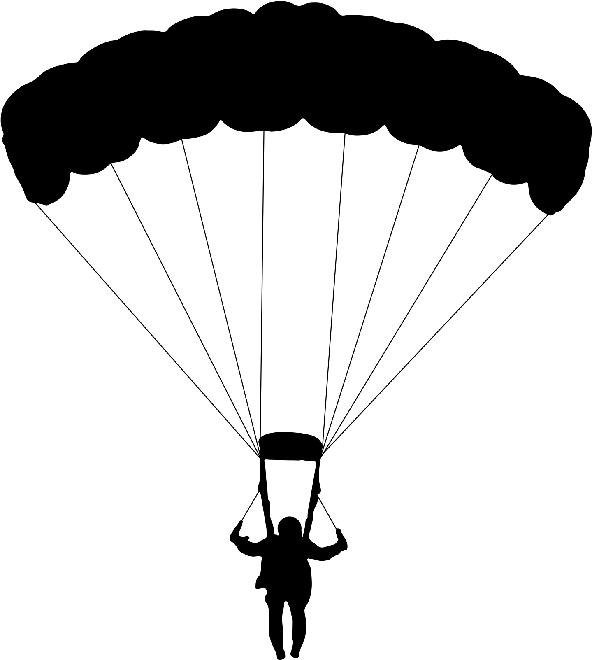




W.A.S.P. Trivia

Slide 2

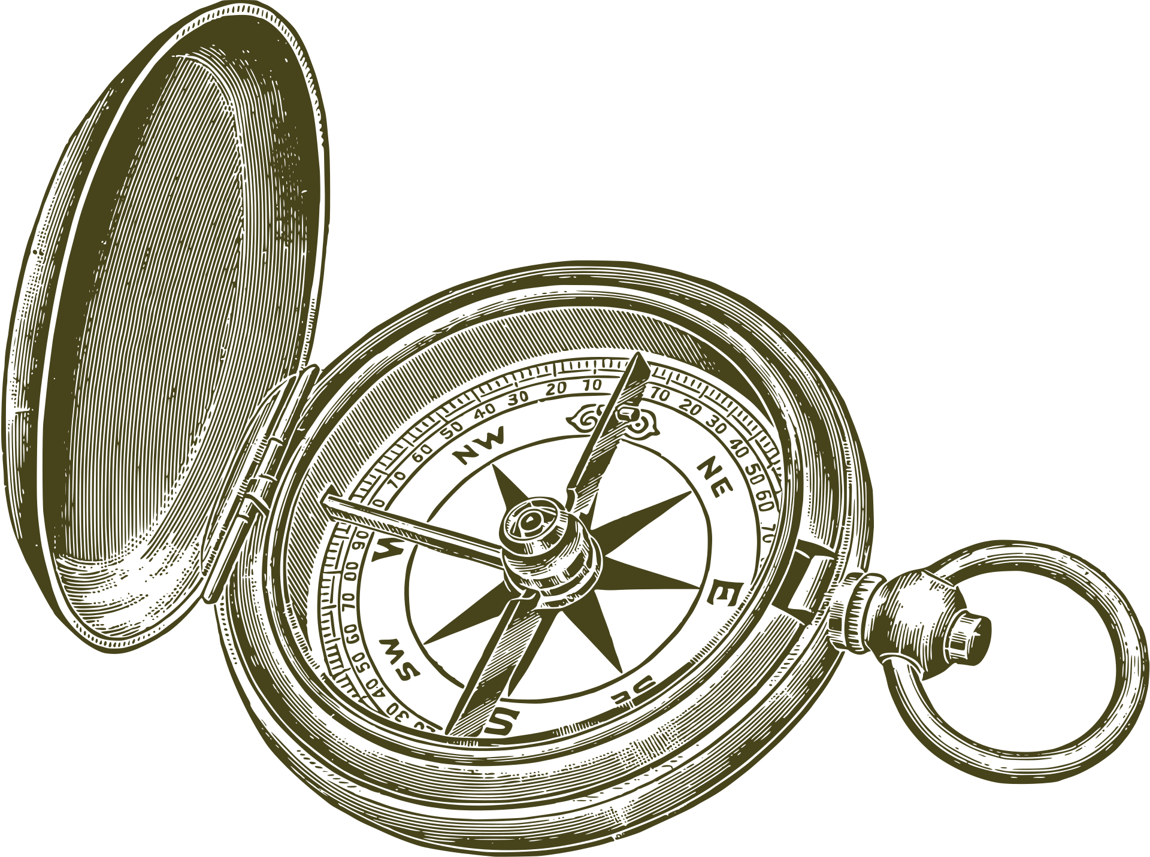
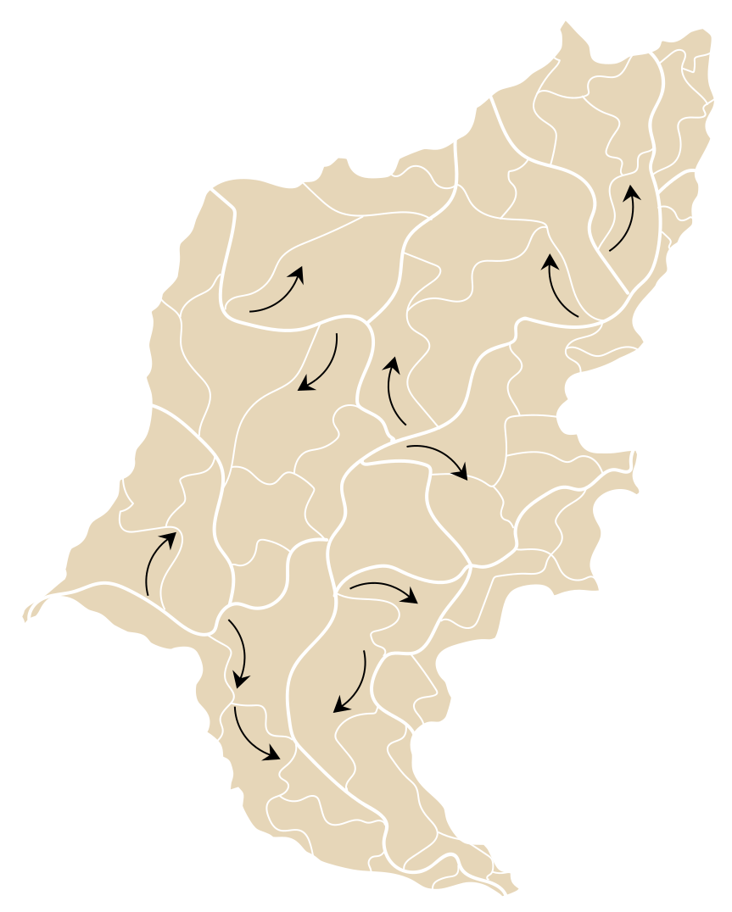

  What year was the WASP officially formed?
A. 1941
B. 1942
C. 1943
D. 1944

Slide 3
  In what year was the WASP officially formed?
A. 1941
B. 1942
C. 1943
D. 1944

Slide 4
  What two organizations merged to form the WASP?
A. ATC + WAFS
B. WATS + USMC
C. WAFS + WFTD
D. WFTD + ATC

Slide 5
  What two organizations merged to form the WASP?
A. ATC + WAFS
B. WATS + USMC
C. WAFS + WFTD
D. WFTD + ATC

Slide 6
  What was the primary reason for forming the WASP?
A. To break aviation records
B. To spy on the Axis powers
C. To help with rationing
D. To free male pilots for combat

Slide 7
  What was the primary reason for forming the WASP?
A. To break aviation records
B. To spy on the Axis powers
C. To help with rationing
D. To free male pilots for combat

Slide 8
  What is the official color of the WASP uniform?
A. Ultramarine Blue
B. Santiago Blue
C. Navy Blue
D. Army Green

Slide 9
  What is the official color of the WASP uniform?
A. Ultramarine Blue
B. Santiago Blue
C. Navy Blue
D. Army Green

Slide 10
  The WASP transported cargo for the U.S. Military, including parts for the atomic bomb
A. True
B. False

Slide 11
  The WASP transported cargo for the U.S. Military, including parts for the atomic bomb
A. True
B. False

Slide 12
  How many WASP made it through training, thus earning their wings?
A. 25,591
B. 3,210
C. 1,830
D. 1,074

Slide 13
  How many WASP made it through training, thus earning their wings?
A. 25,591
B. 3,210
C. 1,830
D. 1,074

Slide 14
  Who was the Director of the WASP?
A. Nancy Harkness Love
B. General Robert Olds
C. General Henry Arnold
D. Jacqueline Cochran

Slide 15
  Who was the Director of the WASP?
A. Nancy Harkness Love
B. General Robert Olds
C. General Henry Arnold
D. Jacqueline Cochran

Slide 16
  The original height requirement for the WASP was 5'0". This requirement was later raised to what height?
A. 5'1
B. 5'2
C. 5'4
D. 5'5

Slide 17
  The original height requirement for the WASP was 5'0". This requirement was later raised to what height?
A. 5'1
B. 5'2
C. 5'4
D. 5'5

Slide 18
  In what city in Texas did every WASP undergo training?
A. Sweetwater
B. Fredericksburg
C. Abilene
D. Waco

Slide 19
  In what city in Texas did every WASP undergo training?
A. Sweetwater
B. Fredericksburg
C. Abilene
D. Waco

Slide 20
  What did the WASP do?
A. Ferry aircraft
B. Tow targets for gunnery practice
C. Test fly aircraft
D. Train other pilots
E. All of the above

Slide 21
  What did the WASP do?
A. Ferry aircraft
B. Tow targets for gunnery practice
C. Test fly aircraft
D. Train other pilots
E. All of the above

Slide 22
  What iconic character is the official mascot of the WASP?
A. Rosie the Riveter
B. Fifinella
C. Minnie Mouse
D. Donald Duck

Slide 23
  What iconic character is the official mascot of the WASP?
A. Rosie the Riveter
B. Fifinella
C. Minnie Mouse
D. Donald Duck

Slide 24
  How many classes graduated from the WASP program?
A. 10
B. 18
C. 20
D. 28

Slide 25
  How many classes graduated from the WASP program?
A. 10
B. 18
C. 20
D. 28

Slide 26
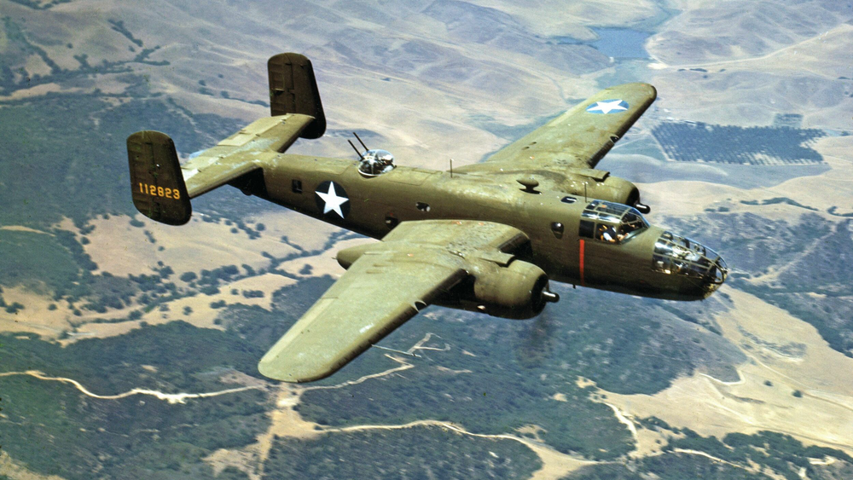
  Many WASP flew this bomber. What is the name?
A. Boeing B-17 Flying Fortress
B. Consolidated B-24 Liberator
C. North American B-25 Mitchell
D. Martin B-26 Marauder

Slide 27
  Many WASP flew this bomber. What is the name?
A. Boeing B-17 Flying Fortress
B. Consolidated B-24 Liberator
C. North American B-25 Mitchell
D. Martin B-26 Marauder

Slide 28
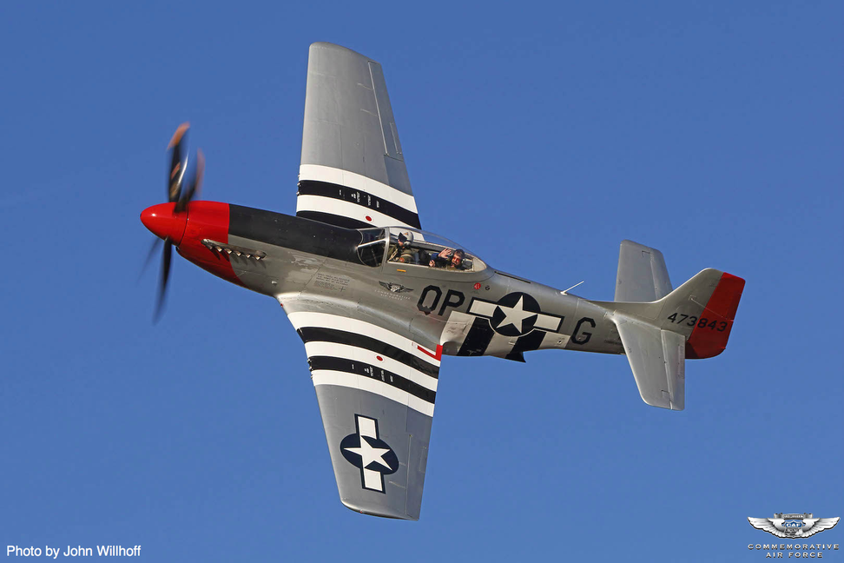
  Many WASP flew this fighter. What is the name?
A. Lockheed P-38 Lightning
B. North American P-51 Mustang
C. Bell P-39 Airacobra
D. Douglas C-47 Skytrain

Slide 29
  Many WASP flew this fighter. What is the name?
A. Lockheed P-38 Lightning
B. North American P-51 Mustang
C. Bell P-39 Airacobra
D. Douglas C-47 Skytrain

Slide 30
  In what year did the WASP program officially end?
A. 1944
B. 1945
C. 1946
D. 1950

Slide 31
  In what year did the WASP program officially end?
A. 1944
B. 1945
C. 1946
D. 1950

Slide 32
  The WASP flew over 60 million miles in 78 different types of airplanes including the fastest pursuit planes and the heaviest bombers
A. True
B. False

Slide 33
  The WASP flew over 60 million miles in 78 different types of airplanes including the fastest pursuit planes and the heaviest bombers
A. True
B. False

Slide 34
  The WASP were the first female official members of the military to fly
A. True
B. False

Slide 35
  The WASP were the first female official members of the military to fly
A. True
B. False

Slide 36
  Who sponsored the bill in 1972 that recognized the WASP as veterans?
A. President Nixon
B. President Carter
C. Mike Mansfield
D. Barry Goldwater

Slide 37
  Who sponsored the bill in 1972 that recognized the WASP as veterans?
A. President Nixon
B. President Carter
C. Mike Mansfield
D. Barry Goldwater

Slide 38
  What year were the WASP awarded the Congressional Gold Medal?
A. 1972
B. 1990
C. 2005
D. 2009

Slide 39
  In what year was the WASP awarded the Congressional Gold Medal?
A. 1972
B. 1990
C. 2005
D. 2009

Slide 40
  What does WASP stand for?
A. Women Airforce Service Pilot
B. Women’s Airforce Service Pilots
C. Women Airforce Service Pilots
D. Women’s Airforce Service Pilot

Slide 41
  What does WASP stand for?
A. Women Airforce Service Pilot
B. Women’s Airforce Service Pilots
C. Women Airforce Service Pilots
D. Women’s Airforce Service Pilot

Slide 42
Count your points!

