Slide 1

scholarships

Slide 2
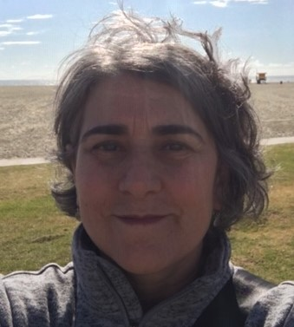
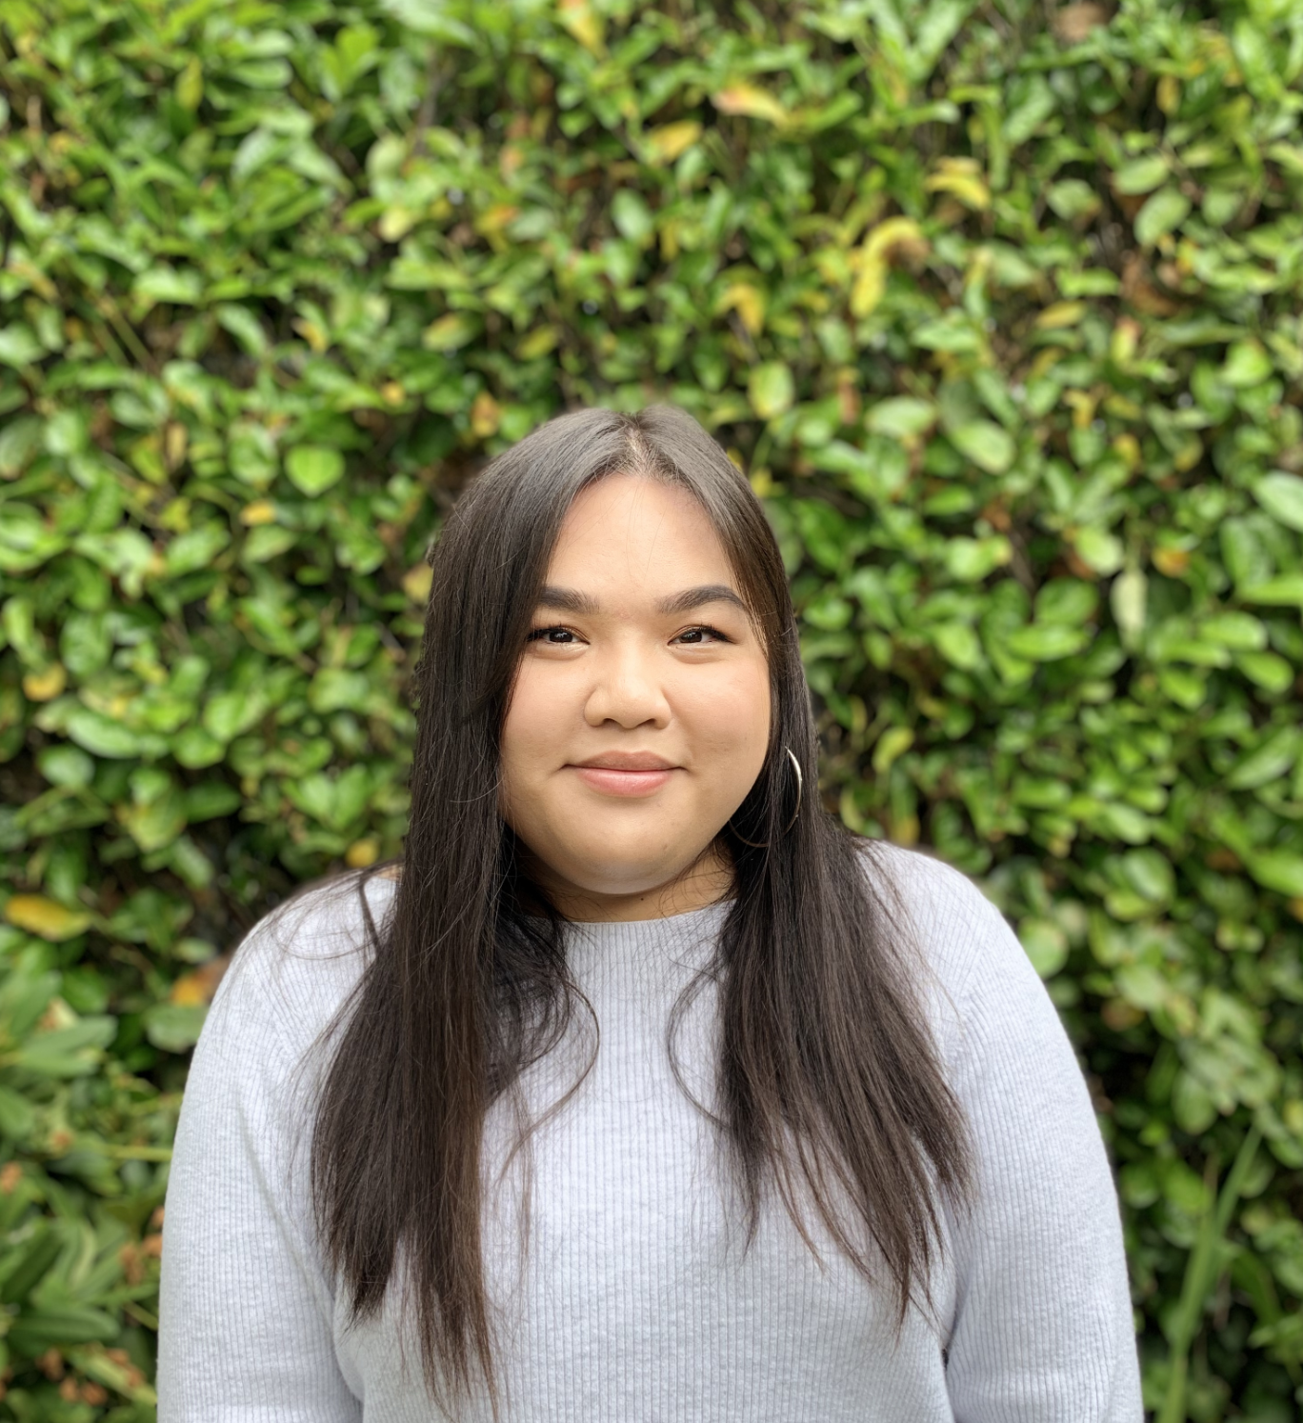
Today's Presenters
Maria Rebecchi
Director, Scholarships & Financial Aid Education
Trang Tran
Program Officer, Scholarships & Financial Aid Education

Slide 3

Today’s Agenda
CSF Scholarships
Resources for Students
Survey Monkey Apply Demo
Notes:
By the end of this presentation, you will know:

Slide 4
CSF Scholarships

Slide 5

Important Dates
Application opens: 12/1/2021
Application closes: 1/31/2022
Deadline to submit documents: 2/7/2022
Notes:
Trang: These are important dates for all four of our scholarship programs. Students will be able to access the online application starting December 1st, 2021. The scholarship applications are due January 31st, 2022. And students are provided an additional week to submit required documents, due by February 7th, 2022.

Slide 6


CSF Scholarships General Checklist
Online application
Unofficial transcript (must include Fall 2021 grades and cumulative GPA)
Letter of recommendation
Supporting documentation must be uploaded in the application
Notes:
Trang: This is a checklist of components of all our scholarships. Each scholarship will be comprised of an online application, and students must submit a high school transcript that includes Fall 2021 grades and their cumulative GPA. They also must have a letter of recommendation submitted on their behalf, as well as have their recommender send to us a recommendation form as well (available on our website). All supporting documentation must be uploaded into the application in SM Apply

Slide 7
1. Leadership 1000
The Leadership 1000 Scholarship provides high school seniors attending certain high schools with scholarships for postsecondary education. Applicants are selected based on academic promise, personal drive and financial need.
In addition to the scholarship, scholars have the opportunity to build relationships with their donors and build their networks. In addition to the scholarship, scholars receive guidance related to college, career, financial aid, and networking opportunities through CSF College Services to ensure students graduate with a four-year degree and achieve success in life. Scholarship Services also provide guidance on matters of financial aid and affordability as well as referrals to on-campus support services.
Scholarships range from $1,000 to $5,000 per year for up to four years, for a maximum of $20,000
For more information: Leadership 1000 Scholarship - College Success Foundation
Notes:
Maria
The first scholarship I will go over is our Leadership 1000 scholarship, or as we like to call it the L1000 scholarship.
This scholarship is for high school seniors attending certain high schools, which we will discuss more in the next slide.
Applicants are selected based on their academic promise, personal drive and must demonstrate financial need.
One unique component of the scholarship is that scholars have the opportunity to build relationships with their donors, the student's scholarships are funded by individual donors and this is a great opportunity for students to extend their networks. This is entirely based what the student would like, but we have seen students receive internship and job opportunities with their donors, or even are able to request additional funding as well.
Students have access to regional and online staff support with our college services division, and scholarship services also provide guidance to financial aid and referrals to campus support.
The L1000 scholarship ranges from $1000-$5000 a year and the scholarship is renewable for up to 4 years, for a maximum of 20,000 dollars.

Slide 8


1. Leadership 1000 Eligibility
Be a high school senior enrolled at an eligible high school and be on track to graduate by June 2022 –OR—
Be a former Achiever attending a Washington state college/university as a freshman, sophomore or junior
Plan to enroll fulltime at an eligible Washington state college or university starting Fall 2022
Have resided in Washington state for at least 12 consecutive months prior to college enrollment (to qualify for in-state tuition)
File a FAFSA or WASFA (to ensure student applies for all possible aid available)
Have a minimum cumulative GPA of 2.5
Have a family income that doesn’t exceed the program’s requirement
Notes:
Maria
To be eligible for the L1000 scholarship, students must be either:
You can find a comprehensive list of schools on our website. Other schools include: Cashmere HS, Wenatchee HS, Westside HS, Eastmont HS, Cascade HS, Liberty Bell HS, White River HS, Quincy HS, Garfield HS, Franklin HS, other
Have resided in Washington state for at least 12 consecutive months prior to college enrollment – have to qualify for in-state tuition and state financial aid
Students must file a FAFSA/WASFA to ensure that the student is eligible for all the aid possible to ensure college affordability

Slide 9
1. Leadership 1000 Eligible high schools
Auburn High School – Auburn
Auburn Mountainview High School – Auburn
Auburn Riverside High School – Auburn
Bremerton High School
Cascade High School
Cashmere High School
Cleveland High School
Columbia High School
Davis High School
DeSales High School
Eastmont High School
Eisenhower High School
Evergreen Educational Complex
Ferris High School
Foss High School
Foss High School
Franklin High School
Garfield High School
Highline High School
Kent-Meridian High School
Kentridge High School
Kentwood High School
Lewis & Clark High School
Liberty Bell High School
Lincoln High School – Tacoma
Lincoln High School – Walla Walla
Marysville Pilchuck High School
Mount Rainier High School
Mount Tahoma High School
Mount Vernon High School
North Central High School
Port Angeles High School
Quincy High School
Rogers High School
Shadle Park High School
Silas High School
Stadium High School
Tyee High School
Waitsburg High School
Walla Walla High School
Wenatchee High School
Westside High School
White River High School
Notes:
Maria
To be eligible for the L1000 scholarship, students must be either:
You can find a comprehensive list of schools on our website. Other schools include: Cashmere HS, Wenatchee HS, Westside HS, Eastmont HS, Cascade HS, Liberty Bell HS, White River HS, Quincy HS, Garfield HS, Franklin HS, other
Have resided in Washington state for at least 12 consecutive months prior to college enrollment – have to qualify for in-state tuition and state financial aid
Students must file a FAFSA/WASFA to ensure that the student is eligible for all the aid possible to ensure college affordability

Slide 10
1. Leadership 1000 Gifts available this coming year...so far!
Financial need
First generation
Landscape Architecture
Creative writing
Finance/Business
STEM/STEAM
Nursing
Residents of Walla Walla, or graduate of Walla Walla high school or CC
Foster youth
Notes:
Maria

Slide 11
2. Governors for foster youth
The Washington State Governors' Scholarship for Foster Youth is a scholarship program that helps high school seniors from foster care continue their education and earn a college degree. The program is supported by Gov. Jay Inslee, The Honorable Chris Gregoire (former governor), The Honorable Gary Locke (former governor), and other former governors in Washington State.
Proceeds from the Governors' Cup – an annual golf tournament – provide funding for approximately 30-40 new scholars each year.
In addition to the scholarship, scholars receive guidance in regards to career, financial aid, and networking opportunities with CSF alumni and scholarship donors to ensure students graduate with a four-year degree and achieve success in life.
Scholarships range from $2,000 to $4,000 per year for up to five years, for a maximum of $20,000
For more information: Governors’ Scholarship for Foster Youth - College Success Foundation
Notes:
Trang
The second scholarship we will go over is the Washington State Governors' scholarship for foster youth, or as we affectionately call it, the Governors' scholarship
The Governors' scholarship is a program that supports students from foster care continue their education and earn a college degree. The program has been supported by several WA state governors', including former governors' Gary Locke and Chris Gregoire, as well as current governor Jay Inslee. Scholarship funds are raised from proceeds of the Governors' cup golf tournament, funding 30-40 scholars a year.
In addition to the scholarship, scholars receive regional or online CSF staff support and networking opportunities with CSF alumni and scholarship donors. The scholarship amount ranges depending on the type of institution the student attends, ranging from $2000 to $4000 and is renewable for up to 5 years, for a maximum of $20,000

Slide 12
2. Governors for foster youth Eligibility
Have a high school diploma or GED by June 2022
Have a minimum cumulative GPA of 2.00
Plan to enroll at an eligible Washington state college or university in fall 2022
Have resided in Washington state for at least 12 consecutive months prior to college enrollment
File a FAFSA or WASFA – to ensure student applies for all possible aid available
Meet one of the following criteria (either currently or until age 18):
Placed by a Washington State court order in any of the following living situations:
Foster Care, Guardianship or Dependency Guardianship (non-relatives, relatives, residential/group care)
Placed in federally-recognized care (private nonprofit agency in Washington state), classified as unaccompanied minor and rendered legal permanent residency in the United States
Placed under a dependency tribal court order outside of your home.
Notes:
Trang: To be eligible for the Governors' scholarship, the student must:
Have a HS diploma or GED by June 2022
The student must have a minimum of a 2.0 cumulative GPA
And must plan on enrolling at an eligible WA state college or university in Fall 2021
Have resided in Washington state for at least 12 consecutive months prior to college enrollment – have to qualify for in-state tuition and state financial aid
And they must file a FAFSA/WASFA
In addition, the student must meet one of the following criteria
They must be either:
Placed by a Washington State court order in any of the following living situations:
Foster Care, Guardianship or Dependency Guardianship (non-relatives, relatives, residential/group care)
Placed in federally-recognized care (private nonprofit agency in Washington state), classified as unaccompanied minor and rendered legal permanent residency in the United States
Placed under a dependency tribal court order outside of your home

Slide 13
3. Martin luther king jr.
The Martin Luther King Jr. Scholarship Fund was created by the Mount Baker Foundation in 1985 as a neighborhood effort to honor the work and dreams of Dr. King. Scholarships are awarded to students who live and go to school in our community.
The goal of this scholarship is to help deserving students achieve the dream of a postsecondary education. The scholarship seeks out students who show financial need, academic promise and who have overcome obstacles while contributing to their community. This community's strong support of scholars is one of the most unique and important attributes of the scholarship. Students who receive this scholarship will have access to regional and online support with CSF.
Scholarships range from $2,000 to $4,000 per year depending on the school of enrollment for a maximum of $16,000.
For more information: Martin Luther King Jr. Scholarship - College Success Foundation
Notes:
Trang: To be eligible for the Governors' scholarship, the student must:
Have a HS diploma or GED by June 2022
The student must have a minimum of a 2.0 cumulative GPA
And must plan on enrolling at an eligible WA state college or university in Fall 2021
Have resided in Washington state for at least 12 consecutive months prior to college enrollment – have to qualify for in-state tuition and state financial aid
And they must file a FAFSA/WASFA
In addition, the student must meet one of the following criteria
They must be either:
Placed by a Washington State court order in any of the following living situations:
Foster Care, Guardianship or Dependency Guardianship (non-relatives, relatives, residential/group care)
Placed in federally-recognized care (private nonprofit agency in Washington state), classified as unaccompanied minor and rendered legal permanent residency in the United States
Placed under a dependency tribal court order outside of your home

Slide 14
3. Martin luther king jr. Eligibility
Be a current high school senior at in the Mount Baker area on track to graduate by June 2022
Be a resident of or attend school in one of the following zip codes: 98104, 98108, 98118, 98122, 98134, 98144; Franklin, Garfield, NOVA, Interagency sites, Rainier Beach, South Lake, Cleveland and independent schools in these zip codes are all eligible
The scholarship is limited to students from ethnic or racial groups that are underrepresented in higher education, especially the following:
American Indian or Alaska Native, Asian (Cambodian, Filipino, Laotian, Vietnamese), African or Black, Hispanic, Pacific Islanders, Multiracial
Have a minimum cumulative GPA of 2.50 (an ideal candidate will have a GPA between 2.5 and 3.6)
Plan to enroll at a not-for-profit, accredited college/university
File a FAFSA or WASFA (to ensure student applies for all possible aid available)
Have a family income that doesn’t exceed the program’s requirement
Notes:
Maria
Students are eligible for the MLK scholarship if they meet the following requirements,
Students must be a high school senior, on track to graduate by June 2022
The student must be a resident of or attend schools in one of the following zip codes on the slide
The scholarship is limited to students from ethnic or racial groups that are underrepresented in higher education, inclusive of the following groups:
Students who identify as: American Indian or Alaska native, Asian, specifically students who are cambodian, filipino, laotion or vietnamese, students who are of african descent or are black, students who are Hispanic, or students who are pacific islander or multi racial
The minimum GPA requirement is a cumulative GPA of 2.5
And the student must enroll at a not-for-profit, accredited college or university anywhere nationwide
Students must file either a FAFSA or WASFA
And meet the income requirements, outlined on our website

Slide 15
APPLICATION SECTIONS
Notes:
Trang
Now we will discuss how reviewers get to know students and evaluate their needs

Slide 16
APPLICATION SECTIONS
Application
Activities
Academic plans
Special circumstances
Short-answer questions
Academics
Transcript
Recommendation
Letter
Rubric
Notes:
Trang
What pieces do reviewers see when evaluating students?
Reviewers are asked to evaluate a student wholistically. We provide reviewers with the following application materials and ask the evaluators to look for the items on the previous slide that Maria discussed. So reviewers look at the student's …

Slide 17
APPLICATION SECTIONS
Application
Activities
Please share why you chose to contribute to the well-being of your family, school, community, or place of worship through these activities you listed above. What have you learned about yourself and others from that experience? (120 words min)
Academic Information Section
Do you need any assistance securing special accommodations or support services on campus (for example: disability/health concerns, housing, tutoring, etc.)? If this doesn’t apply to you, please write ‘N/A’.
Family and/or Supporting Adult Info Section
Do you or your family have additional circumstances that we should consider (for example, loss of job, housing or food instability, lack of transportation, health concerns, etc.? As much as you are comfortable, please share these circumstances so that we can better evaluate your application and so that we can connect you with support services. If this doesn’t apply to you, please write ‘N/A’.
Notes:
In addition to the prompts, students also have the opportunity to provide additional details about themselves in the activities, academic and family and/or supporting adult sections of the applications.
In the activities section, we want to know about how the student contribute to their community. By community, this is all defined by the student, we don’t have any limitations to how students could define their community. This could be supporting their family, or in their school, place of worship, or any other community they consider themselves to be a part of. We want to know why the student chose to participate in their community, and what did they learn about themselves or others in these experiences.
The other two questions are optional, but are helpful for CSF to coordinate future support the student may need while in college. So the student can talk about any special accommodations or support services they may need in the academic section, and detail any additional circumstances their family may be experiencing in the family/supporting adult information section. Students can share as much as they are comfortable sharing about any circumstances we should consider, for example: loss of job in the family, housing or food instability, lack of transportation, health concerns, etc. This information is really helpful for us to ensure the student has all the support they need to ensure their success.

Slide 18
Short-answer questions
College is a stepping-stone to your life and your career. What are your goals, what do you aspire to be, and how do you see higher education helping you get there? What have you done and what are you doing now to ensure you are prepared for the next step?
In thinking about your educational and career goals, provide examples of:
A strength that will help you achieve your objectives
A personal vulnerability that might get in the way of your success and the steps you will take to address them
When confronted with a need for support or advice, what living person do you turn to for guidance? Describe a situation when that person helped you. If he or she did not have the knowledge to help you, what would you do next?
Describe a challenge you have faced and share how you dealt with it. Explain how having dealt with that challenge has shaped you, the lessons you learned and if it has influenced your goals for the future
Notes:
Maria
Students are able to showcase who they are through the essay prompts. The following essay prompts are for the L1000, Governors' and MLK scholarships, so students who are eligible for all three scholarships can use the same responses for each application.
Let me take a second to go over the essay prompts:
The first essay prompt really interested in getting to know what the students goals are, how higher education supports their goals and what they have done to prepare so far to accomplish their goals.
The second essay prompt looks for students to reflect on a strength that may help the student in achieving their goals, and a personal vulnerability that may get in the way of their success. We also want to hear how the student plans to address their personal vulnerability as well in the context of their college and career goals.
The third prompt is looking at how students seek support or guidance, and detailing when they sought the support or guidance from a living person. We also want to look at if their support person didn't have the answers they needed, what would the student do next.
The last essay asks the student to describe a challenge they’ve experienced, and how did they deal with it. The second part of the question asks how did dealing with the challenge shape the student, what did the student learn from this challenge, and has this experience influenced any of their future goals.

Slide 19
Short-answer questions
NEW this year:
Student will be able to replace one of their essays with something that they’ve created. It could be a website, an art project, a personal video or other online file that they would like to share. You’ll place the link in the answer section. They will have to explain what it is and how it addresses the prompt.
Here are some samples:
Marithza (Goals)
Vivian (Challenges)
Iking (Self-awareness)
Emily (Support person)
Kelly (Community engagement)
Mojo (Multiple)
Abigail (Self-awareness)
Jari (Goals)
Naira (Multiple)

Slide 20
Short-answer questions Tips
Minimum of 500 words are required for each essay. We strongly recommend that students do the following:
Read all the questions first and outline responses in Word
Use different examples throughout their application to build the most complete picture of themselves as a unique applicant. The more details, the stronger the answers.
Share drafts with a teacher, advisor, coach or adult for feedback [refer to scheduled sessions]
Answers will be evaluated for focus, development of ideas, coherence, organization, substance and appropriate expression.
Remember that this is the only chance evaluators will have to get to know who they are and what they hope to do with their education. Make sure it counts!
Notes:
Trang:
Lastly, we want to share some essay tips for the essay prompts we discussed earlier for you to share with your students. The four essays are a minimum of 500 words required, and we strongly recommend the students do each of the following to ensure a successful essay
Is there a focus (central idea), that is sustained with examples, details, descriptions (each paragraph supports/expands thesis), can they connect goals to career, to preparation, complete sentences, are paragraphs connected to each other and to main idea? Does it make sense as a whole?

Slide 21
After submission All programs
Awards:
Selected scholars will be notified by April 15
Selected scholars will have to accept award by April 30
You must submit your financial aid award letter to complete the awarding process
Selected scholars to attend an online orientation in May
Notes:
Maria
Now we will discuss what happens after submission for all four scholarship programs
Selected scholars will be notified by April 15
Selected scholars will have to accept award by April 30 –failure to accept will result in a rescinded scholarship
You must submit your financial aid award letter to complete the awarding process
Selected scholars to attend an online orientation in May

Slide 22
Documents required by program
 | Leadership 1000 | Governors' | MLK
Unofficial Transcript | Must include Fall 2020 grades and cumulative GPA *We will be lenient with late grade submissions
Letter of Recommendation | 1 Letter Required | 1 Letter Required | 1 Letter1 Required
Dependency Court Order | N/A | Required | N/A
Notes:
Now we will go over the documents required by each program, as the documents differ slightly by program.
For unofficial transcripts, students applying to all four programs must submit an unofficial transcript that includes Fall 2020 grades and their cumulative GPA – we recognize that some students may not have their fall grades posted on their transcript by the February 7th deadline, so we will be lenient with transcripts, given that the student communicates with us
All scholarship will require a letter of recommendation and have recommenders submit the recommendation form that can be found on our website. The L1000, Governor's and Sunshine brooks only require 1 recommendation, but the MLK scholarship will need 2 recommendations.
Lastly, the Governors' scholarship will require that the student submit a copy of their state, federal or tribal dependency court order to confirm their foster care status.

Slide 23
Resources for STUDENTS
CSF Essay Brainstorm/Feedback Clinic with Alumni Board Members sessions
Dec 11, 2021 11 AM – 1 PM
Dec 16, 2021 6 PM – 7 PM
Jan 8, 2022 11 AM – 1 PM
Jan 13, 2022 6 PM – 7 PM
GetSchooled’s essay review: College Application Essay Review |
Student Application Guide – coming soon!
Promo flyer w/ links to register will be emailed to you
Notes:
Trang
If you have any students who would be eligible for any four of these scholarships, please invite them to one of the following scholarship informational sessions on November. I will send the flyers and registration links to all who attended the session today later this week, so please forward to any students who may be interested.

Slide 24
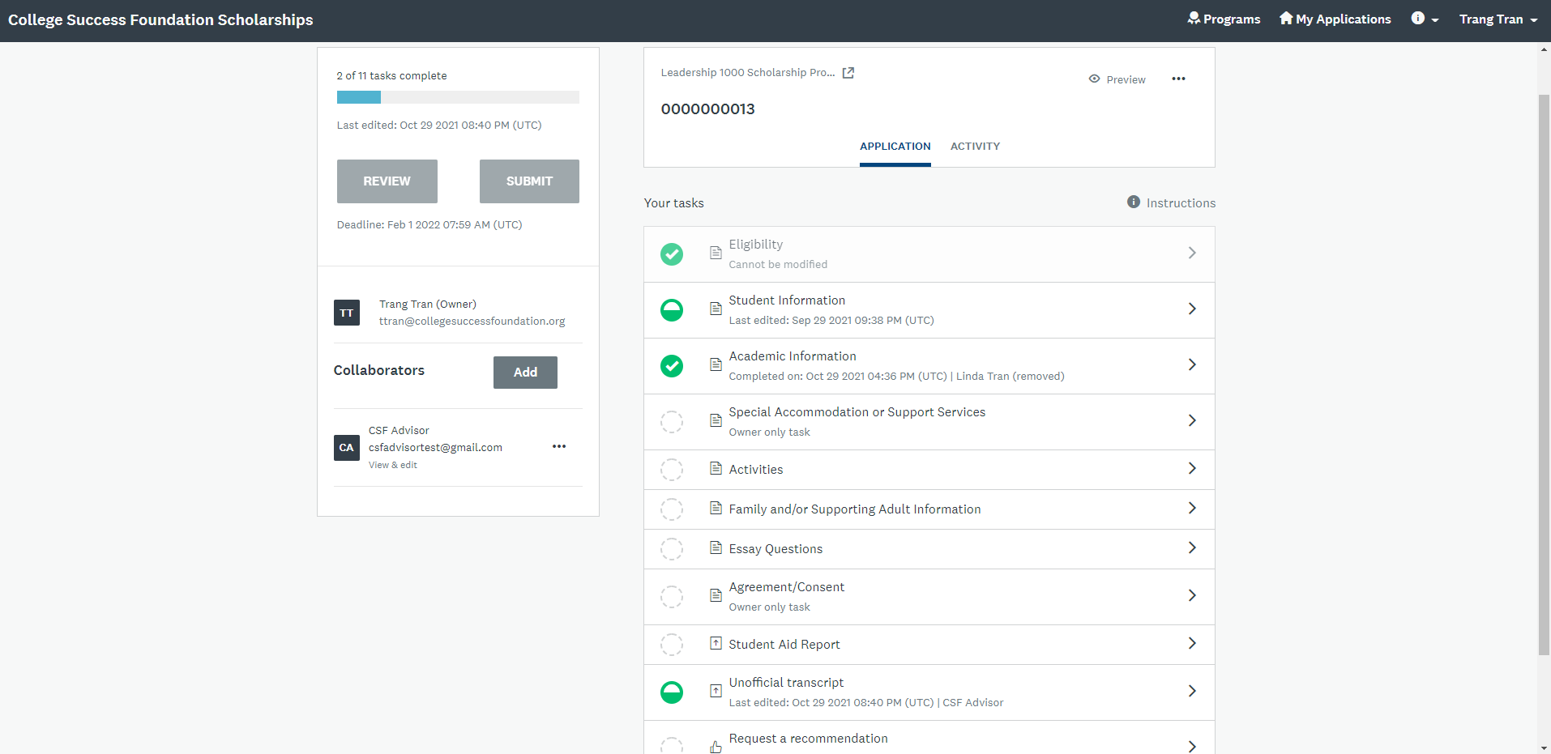
Scholarship platform demo Applicant perspective
Helpful features
Reusable applicant tasks (for students applying to multiple scholarships)
Shows applicant progress on tasks
Informs applicant when recommendations are accepted/declined/received
Can invite collaborators (advisors) to upload transcripts on their behalf
Access to Survey Monkey Help team, and site navigation FAQ

Slide 25

Questions? Comments? Help?
Maria Rebecchi
Director, Scholarships & Financial Aid Education
Mrebecchi@collegesuccessfoundation.org
Trang Tran
Program Officer, Scholarship Services
Ttran@collegesuccessfoundation.org

