Slide 4
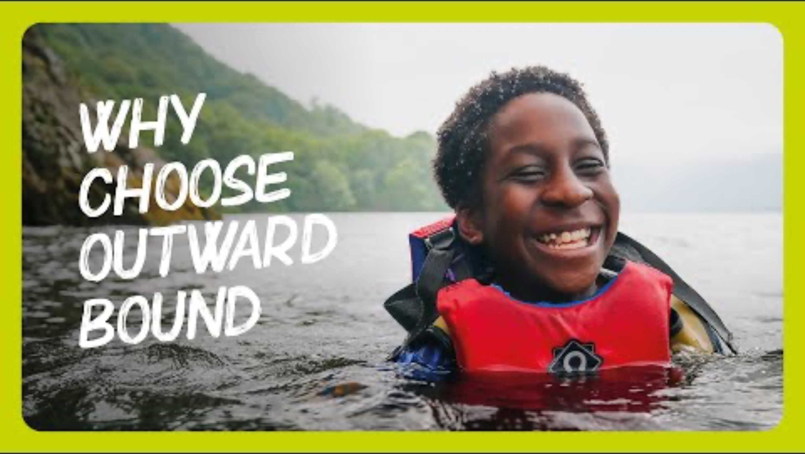
YOUR OUTWARD BOUND RESIDENTIAL
We’re looking forward to welcoming you to our centre.
Here’s a few things you need to know to make sure your Young Person has the best residential.
But first, here’s a little taste of what to expect…
YouTube link

Slide 5
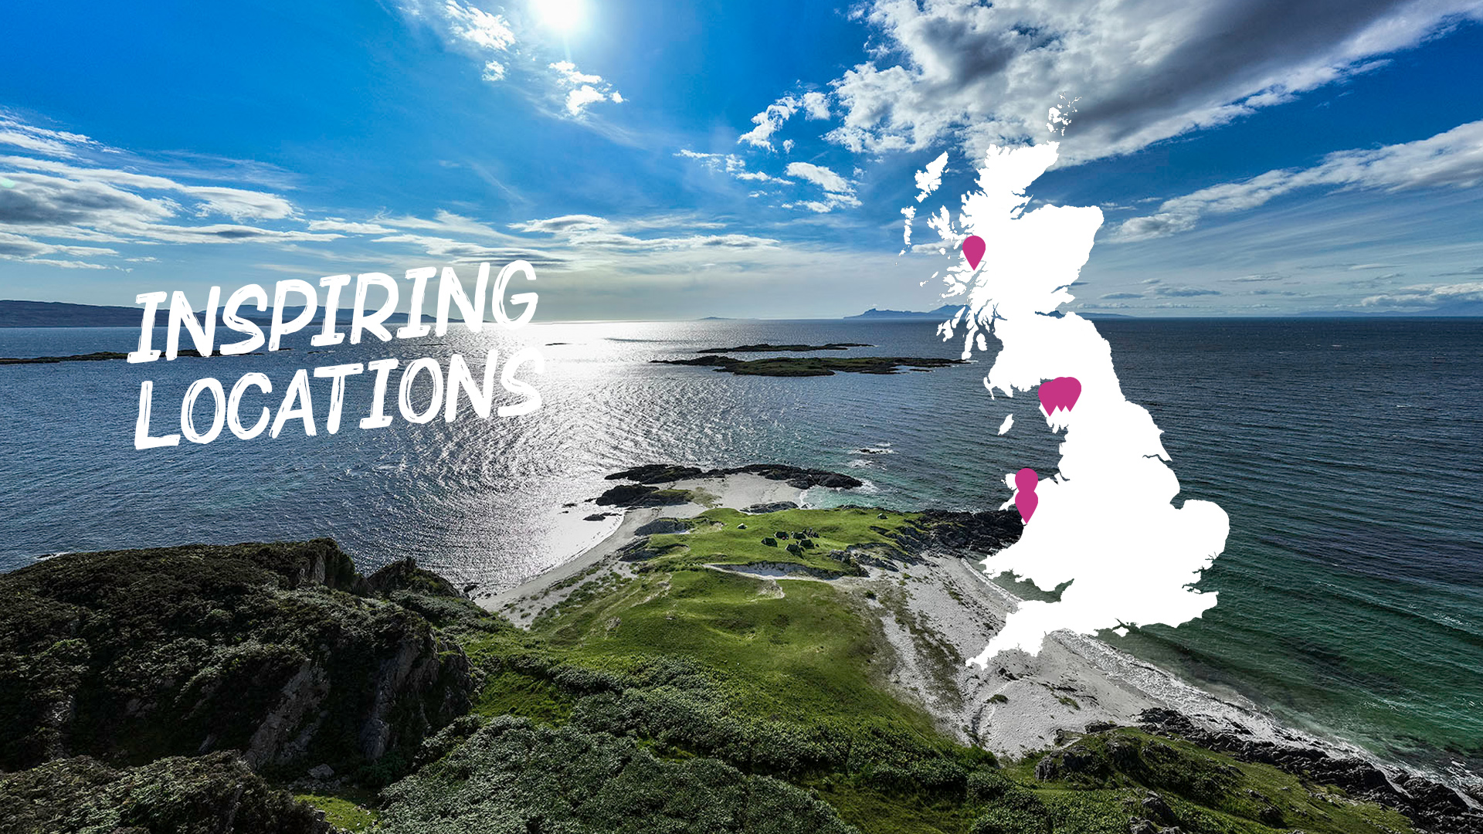
Explore our centres

Slide 6
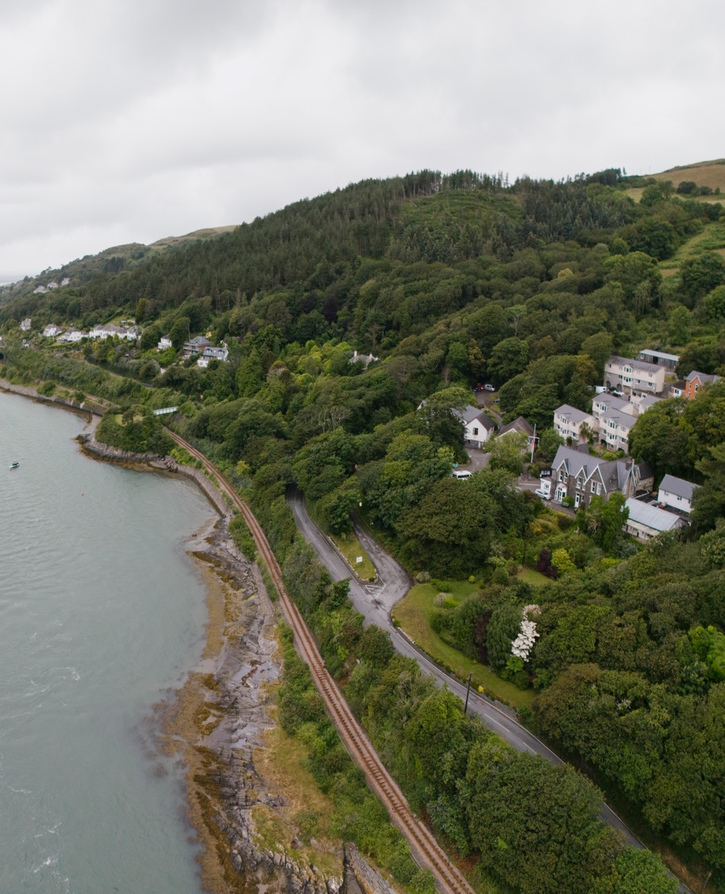
LIFE AT CENTRE: ABERDYFI
Our Aberdyfi Centre sits right on the edge of Eryri (Snowdonia) National Park.
There’s something about arriving in Aberdyfi (Aberdovey) that feels different to anywhere else, especially if you’ve come from a busy place. There's no traffic noise, no sirens. Just the rhythm of the tide and the sound of seabirds flying overhead.
From this place, young people can hit the beach, scramble through woodland, and hike into the hills - all in a single day. Every activity is rooted in the environment, building teamwork, decision-making and resilience.
Watch our centre tour
Visit our centre page

Slide 7
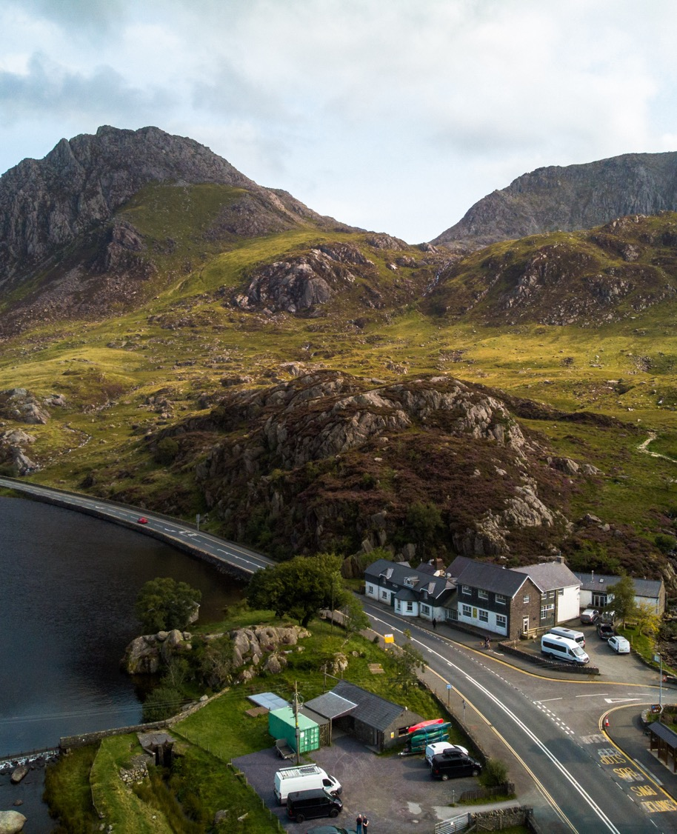
LIFE AT CENTRE: OGWEN
Our Ogwen Cottage Centre sits in the dramatic foothills of Glyderau and Yr Wyddfa (Snowdon), where rugged peaks rise straight from the valley floor.
You don’t have to go far to feel a world away. Step outside Ogwen Cottage and you’re surrounded by lakes, woodlands and mountains. It’s a place full of new sights, new sounds, and new experiences – all waiting just beyond the doorstep.
Here, you’re minutes from wild swimming spots, climbing routes, and trails that lead straight to the summits. Every day brings something new. Each challenge builds confidence, teamwork and self-awareness – with the mountains as your classroom.
Watch our centre tour
Visit our centre page

Slide 8
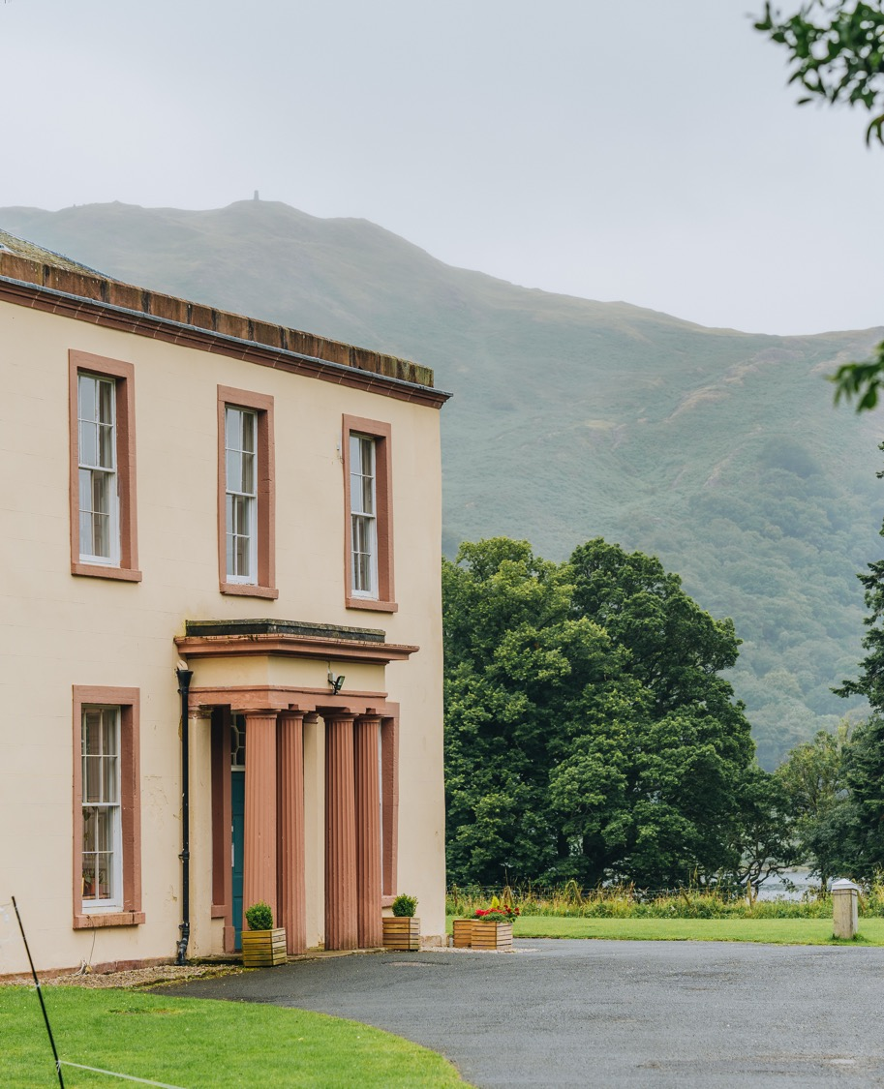
LIFE AT CENTRE: Ullswater
Our Ullswater Centre sits right on the shore of the lake, set in 18 acres of woodland and surrounded by towering fells.
It’s no surprise this landscape inspired Wordsworth’s famous ode to the daffodils. With ever-changing flora and fauna, it’s a stunning destination to come to year-round. As you journey through The Lakes, you’ll discover a place that feels brighter, fresher, and more tranquil than almost anywhere else you’ve experienced.
Perfectly suited for outdoor learning, this is a place where young people can push off in a canoe at first light, reach a summit by midday, and reflect by the water’s edge before nightfall.
Watch our centre tour
Visit our centre page

Slide 9
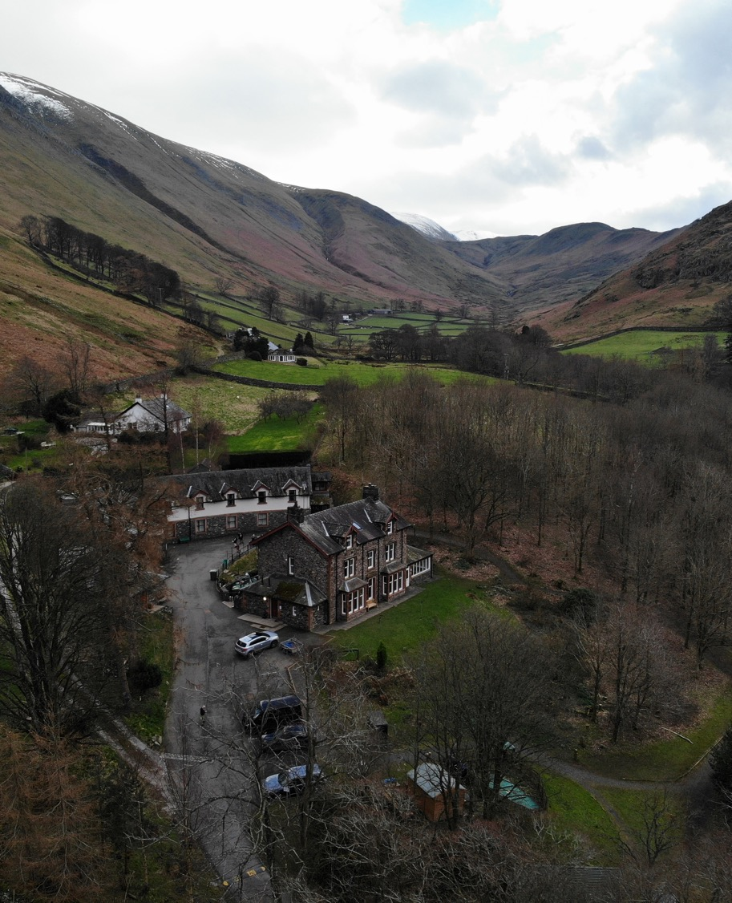
LIFE AT CENTRE: HOWTOWN
Our Howtown Centre sits in a sheltered bay on the shores of Ullswater, in the heart of the Lake District National Park.
Reaching Howtown means slowing down. The road narrows, the noise fades, and Ullswater comes into view. With the lake on one side and steep fells on the other, it feels like you’ve left the world behind - and arrived somewhere that’s all yours.
Visit our centre page

Slide 10
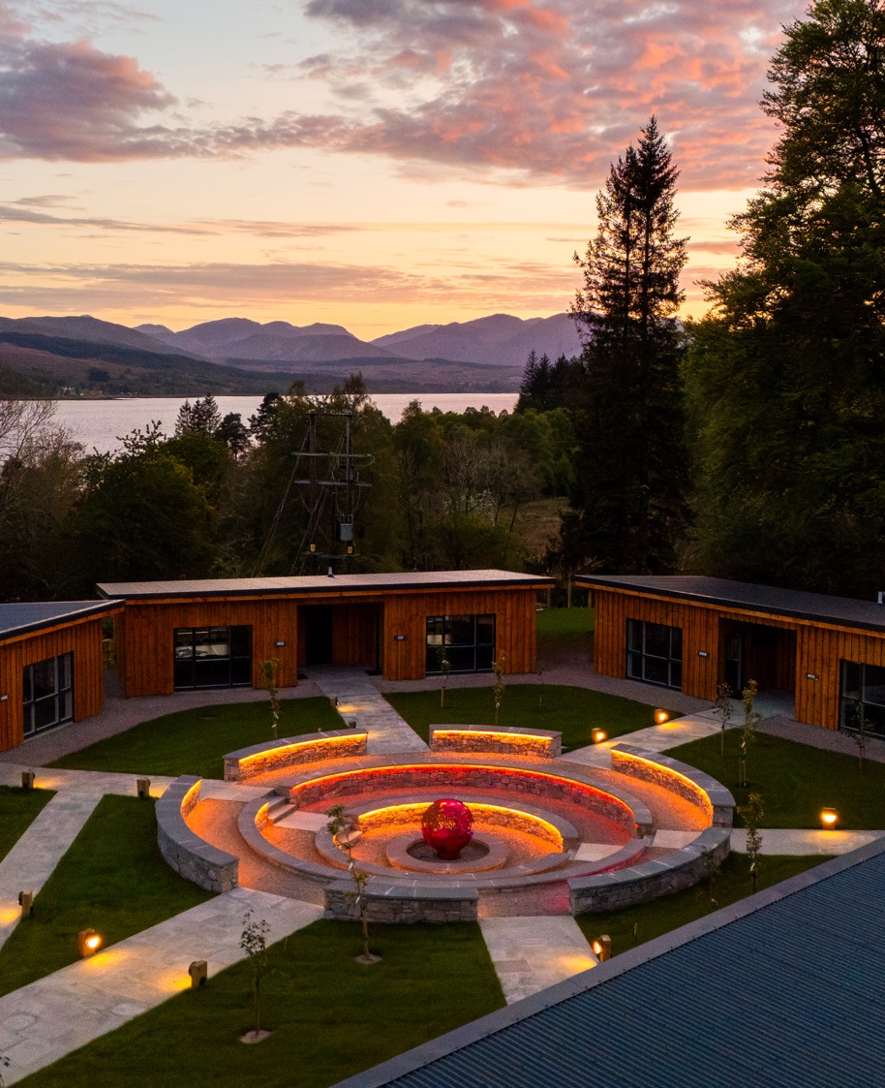
LIFE AT CENTRE: LOCH EIL
Our Loch Eil Centre sits in the heart of the UK’s outdoor capital - a place packed with wild beauty and big possibilities. Think beaches, glens, freshwater lochs and rivers…and Ben Nevis towering over it all.
Coming to Loch Eil feels like stepping into another world. The air is fresh. The loch stretches out in front of you. Huge mountains rise up all around. Even the weather feels bigger up here. It’s wild and remote, but full of life. And once you’re here, it doesn’t take long to feel part of it.
Watch our centre tour
Visit our centre page

Slide 11
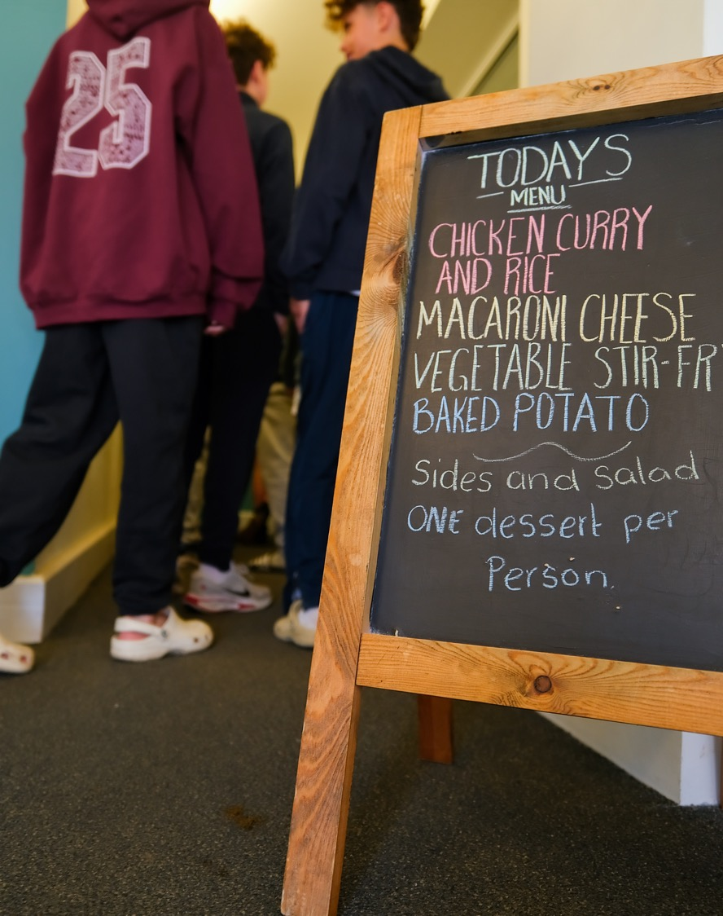
Creature comforts
Staying away from home can be a little scary, we know that, so our friendly team do all they can to make your child feel settled from the get go.
What are the dorm rooms like?
Dorms vary in size, with bunk beds and some en-suites. Roommates are assigned by your school or by Outward Bound.
Where do I shower?
Some rooms have en-suite showers, or shared facilities nearby.
Are there charging points in the dorm rooms?
Yes, there are plug sockets in dorm rooms and common areas.
Will my dietary requirements be catered for?
Yes. Let us know in your Participant Information Form and our catering team will make sure your needs are met.
Have a look at our Help Centre page for more answers to some of your questions.
Click here.

Slide 12
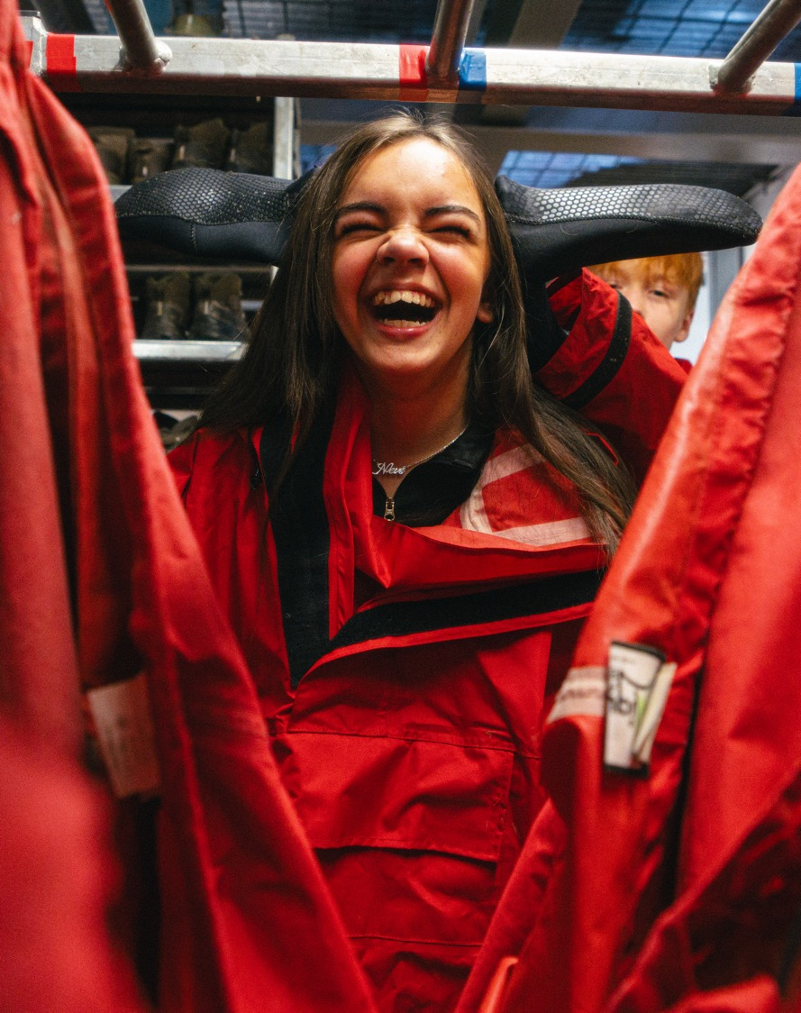
KIT LIST
What to pack?
We’ll provide you with walking boots, waterproofs, a rucksack, a roll mat, and a sleeping bag (where appropriate), so don’t worry about bringing these. You can bring your own kit if you have it, but most people prefer to borrow ours.
All you need to bring is personal clothing and footwear, including things to wear during the evening, when you're not taking part in activities.
We advise leaving any valuable items behind. We can give you access to a safety deposit box, and if you’re travelling from abroad, please keep your passport and important travel documents there.
Have a look at our Help Centre to find our full Kit List.
Click here.

Slide 13
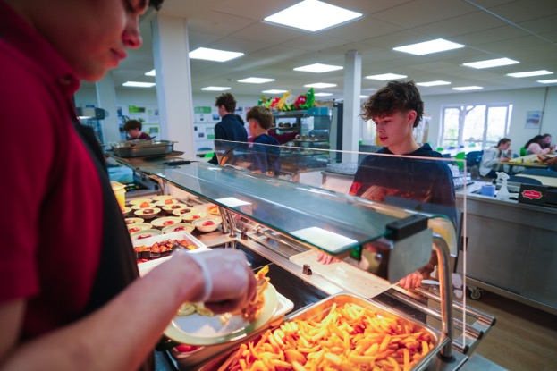
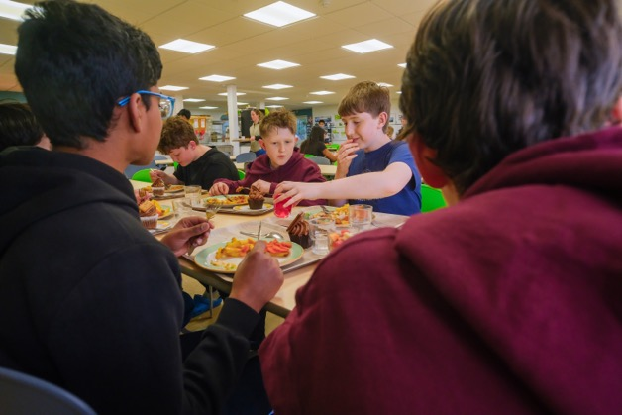
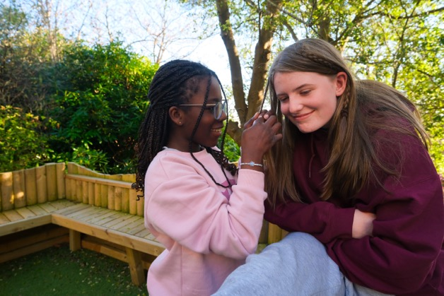
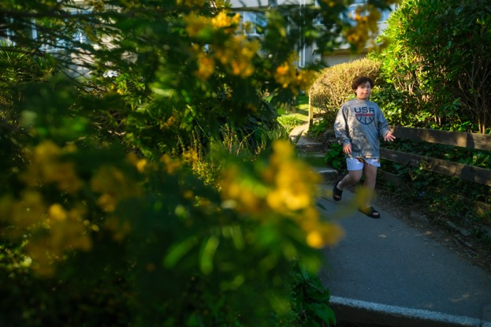
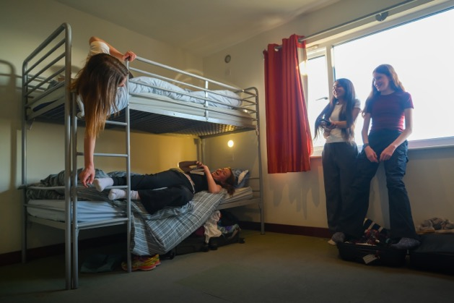
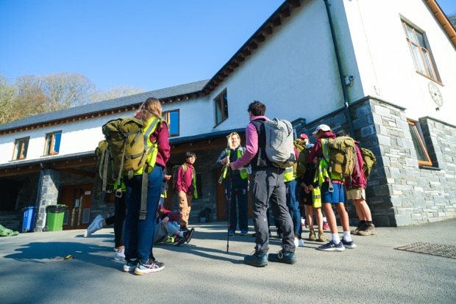
WHAT TO EXPECT

Slide 14
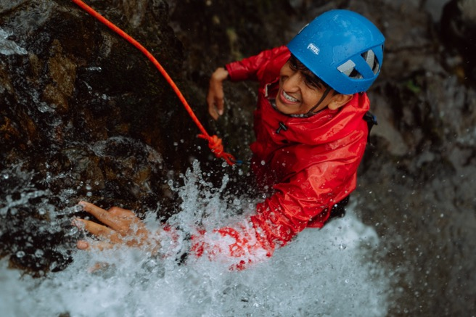
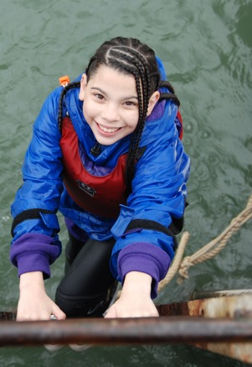
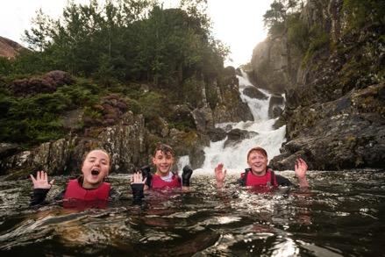
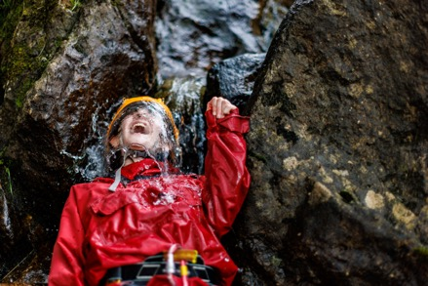
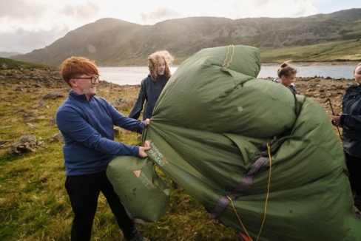
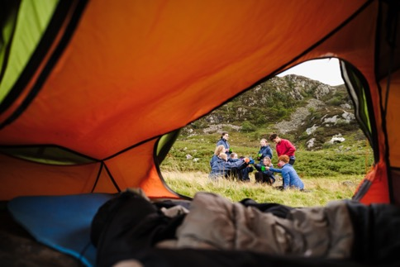
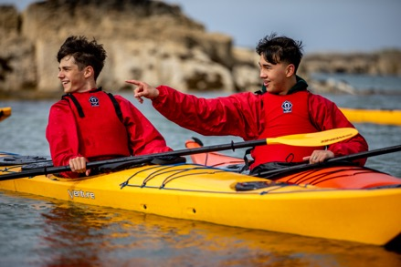
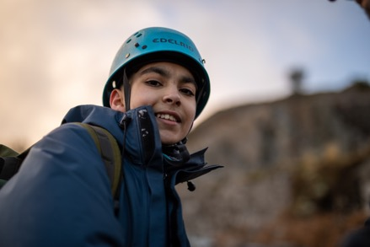
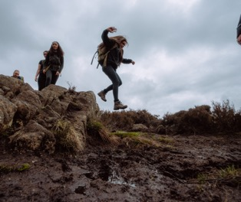
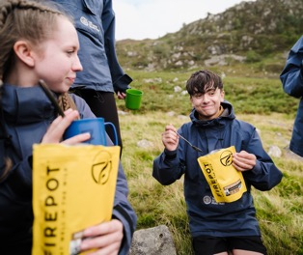
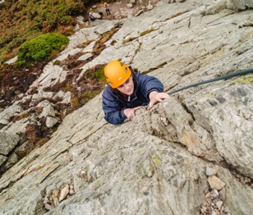
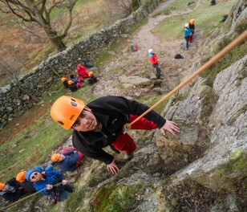
LIFE AWAY FROM CENTRE
At Outward Bound, learning happens through experience. Out in the wild, pupils face real challenges and discover what they’re made of.
Guided by expert instructors, they’ll step beyond the classroom. Hike, climb, camp, canoe. Not just for the thrill, but to build character, confidence and resilience.

Slide 15
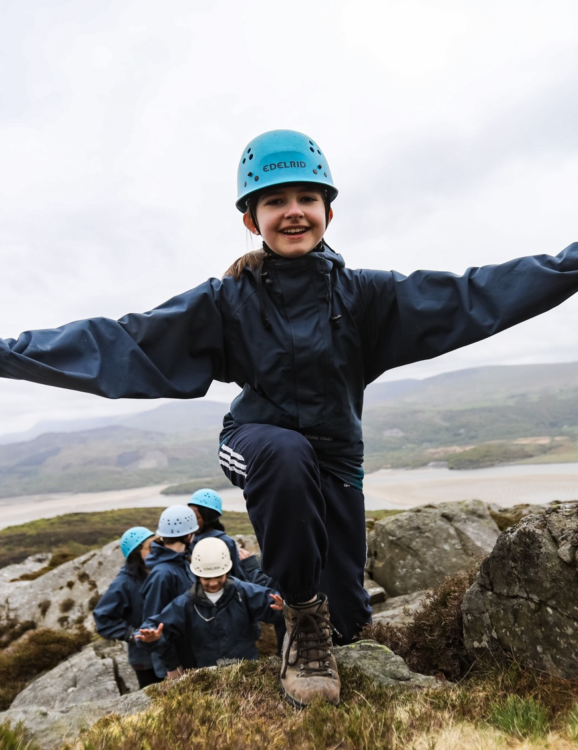
A typical day
​
7.00am – wake up, wash, dress, breakfast​
​
8.30am – morning meeting (teachers)​
​
9.00am - 5pm – full day of adventure learning​
​
5.30pm – evening meal​
​
7.00pm – evening session​
​
8.30pm – free time, then bed
Notes:
Why We’re Here Today​
“We’re here to understand your goals and explore how we can help your pupils thrive.”​
Frame it as a conversation, not a pitch!​
What they gain:​​
Confidence in themselves and their abilities​​
Stronger social skills and sense of belonging​​
Understanding of, and compassion for others ​​
Resilience to dig deep and keep going when things get tough​​
Awareness of the environment and the world around them​​​
​By the time they leave, they see themselves and what they’re capable of in a whole new light. ​

Slide 16
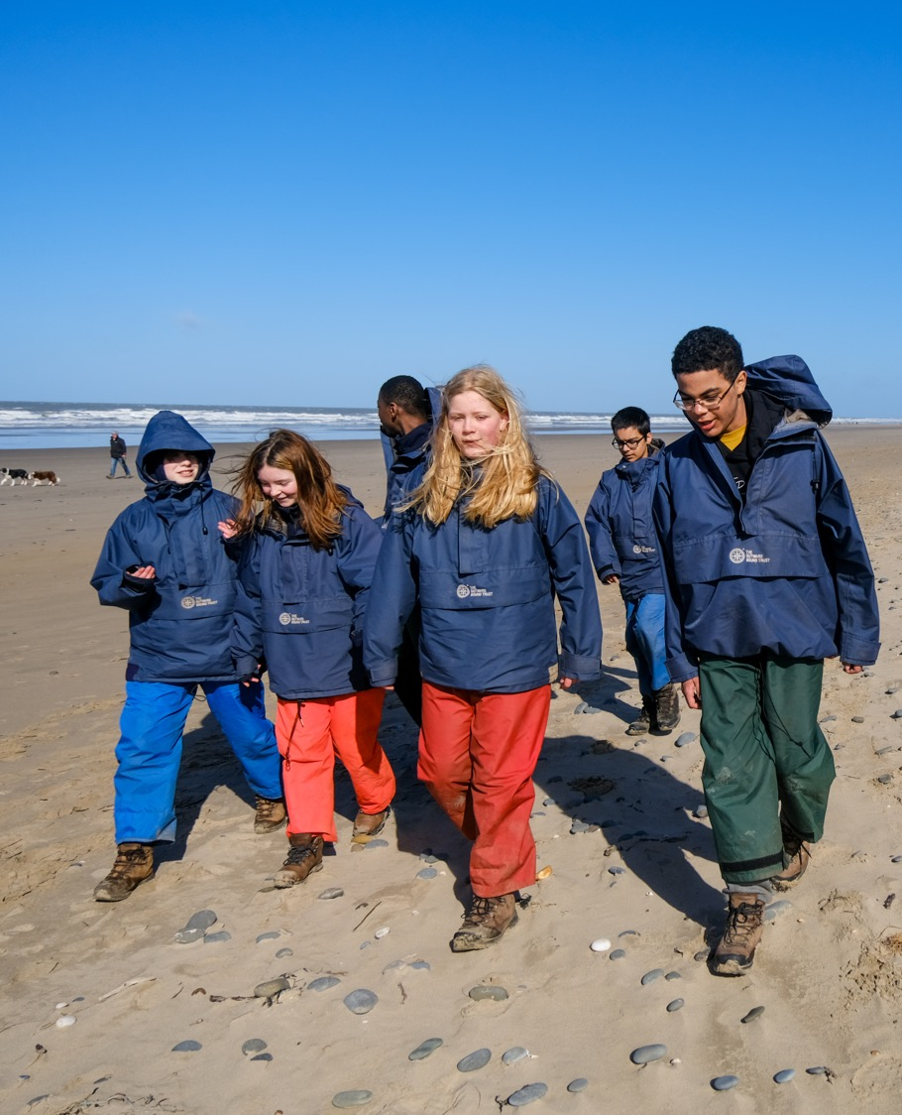
A typical day
7.00am – wake up, wash, dress, breakfast
8.30am – morning meeting (teachers)
9.00am - 5pm – full day of adventure learning
5.30pm – evening meal
7.00pm – evening session
8.30pm – free time, then bed
Notes:
Why We’re Here Today​
“We’re here to understand your goals and explore how we can help your pupils thrive.”​
Frame it as a conversation, not a pitch!​
What they gain:​​
Confidence in themselves and their abilities​​
Stronger social skills and sense of belonging​​
Understanding of, and compassion for others ​​
Resilience to dig deep and keep going when things get tough​​
Awareness of the environment and the world around them​​​
​By the time they leave, they see themselves and what they’re capable of in a whole new light. ​

Slide 18
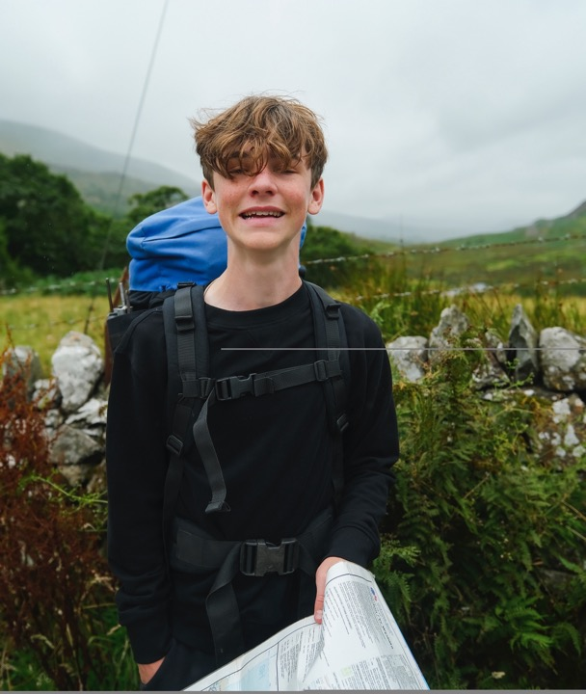


"We choose Outward Bound because it goes far beyond outdoor activities. It’s the intentional focus on character development, resilience, and values-led learning that sets it apart. The programmes are thoughtfully designed to challenge students in a way that builds self-belief, leadership, and a sense of responsibility not just for themselves, but for others."​
Kath Pidgon - Deputy Headteacher

Slide 19
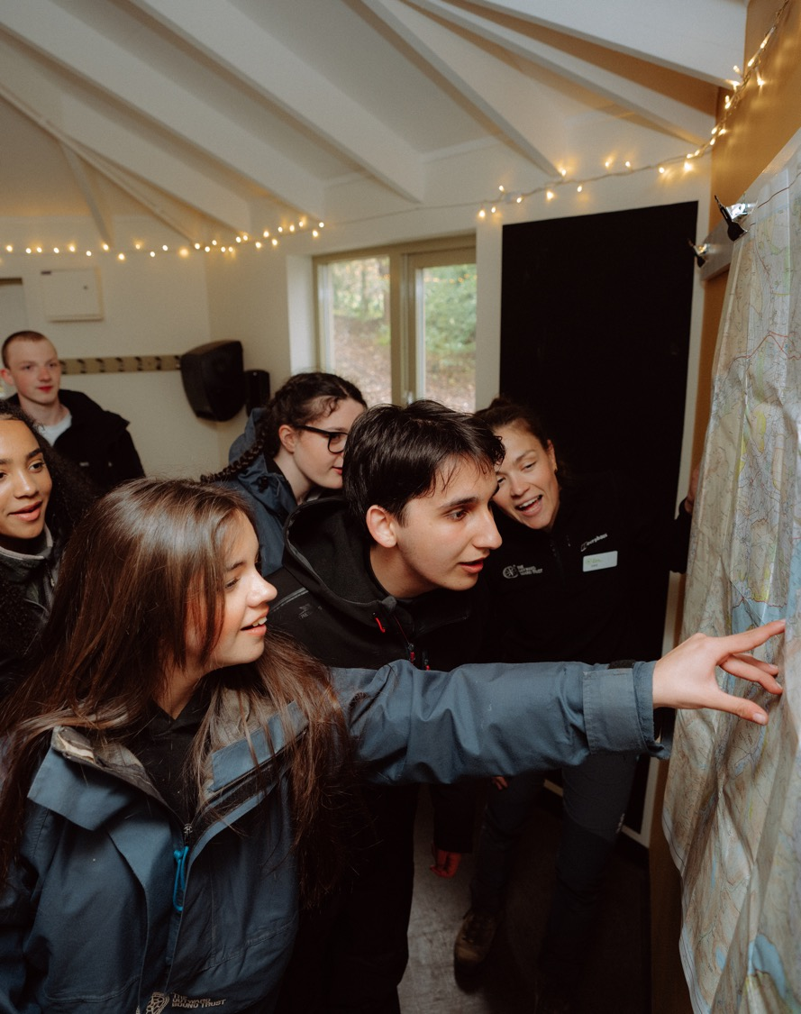
TRAVEL
Teacher to add in information specific to travel timings etc.
Notes:
Why We’re Here Today​
“We’re here to understand your goals and explore how we can help your pupils thrive.”​
Frame it as a conversation, not a pitch!​
What they gain:​​
Confidence in themselves and their abilities​​
Stronger social skills and sense of belonging​​
Understanding of, and compassion for others ​​
Resilience to dig deep and keep going when things get tough​​
Awareness of the environment and the world around them​​​
​By the time they leave, they see themselves and what they’re capable of in a whole new light. ​

Slide 20
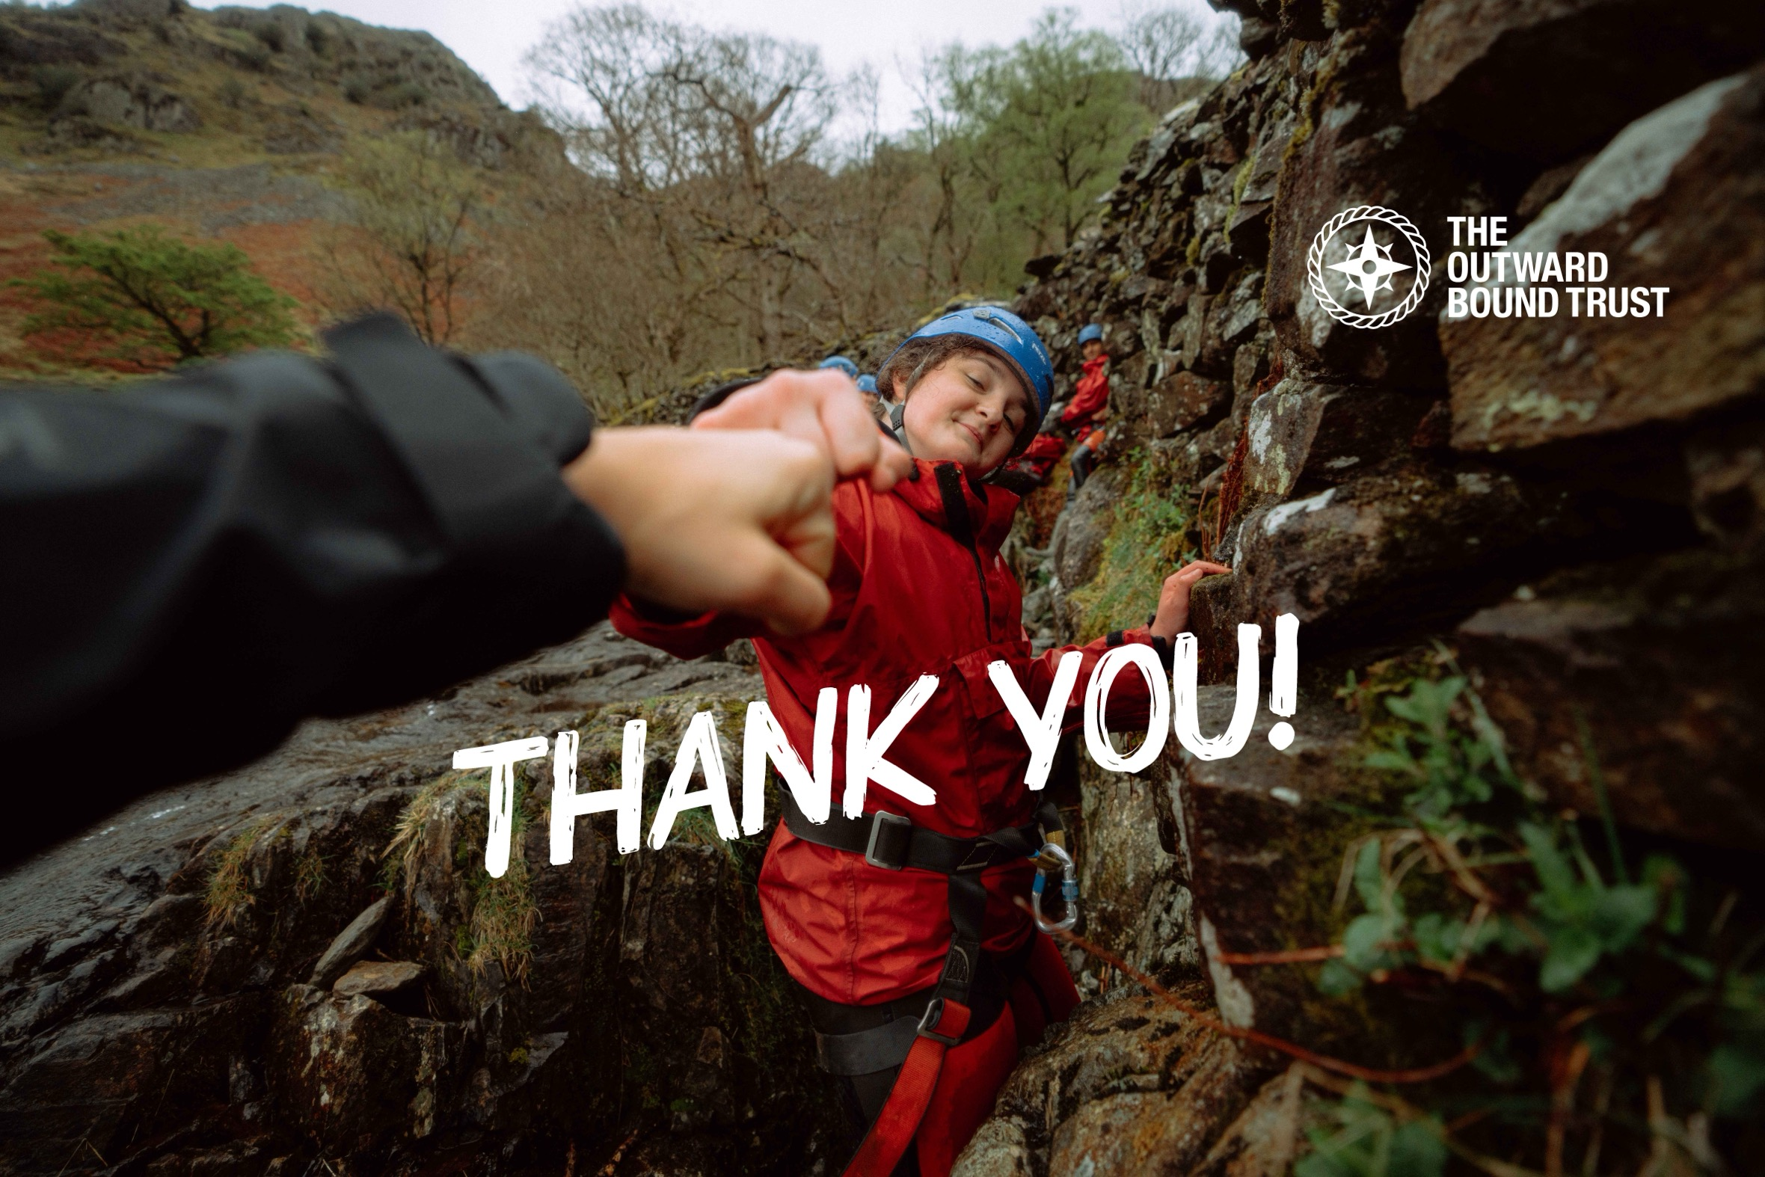

Slide 21
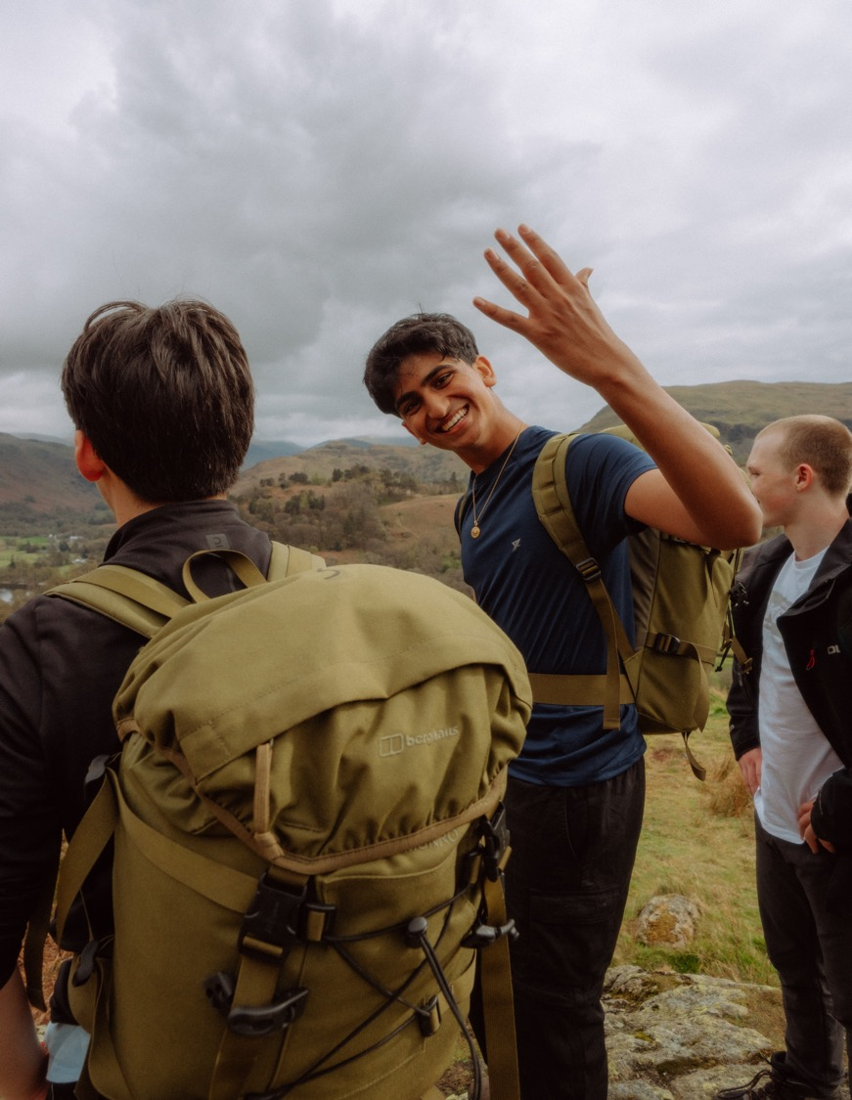
TITLE
Copy
Notes:
Why We’re Here Today​
“We’re here to understand your goals and explore how we can help your pupils thrive.”​
Frame it as a conversation, not a pitch!​
What they gain:​​
Confidence in themselves and their abilities​​
Stronger social skills and sense of belonging​​
Understanding of, and compassion for others ​​
Resilience to dig deep and keep going when things get tough​​
Awareness of the environment and the world around them​​​
​By the time they leave, they see themselves and what they’re capable of in a whole new light. ​

Slide 22
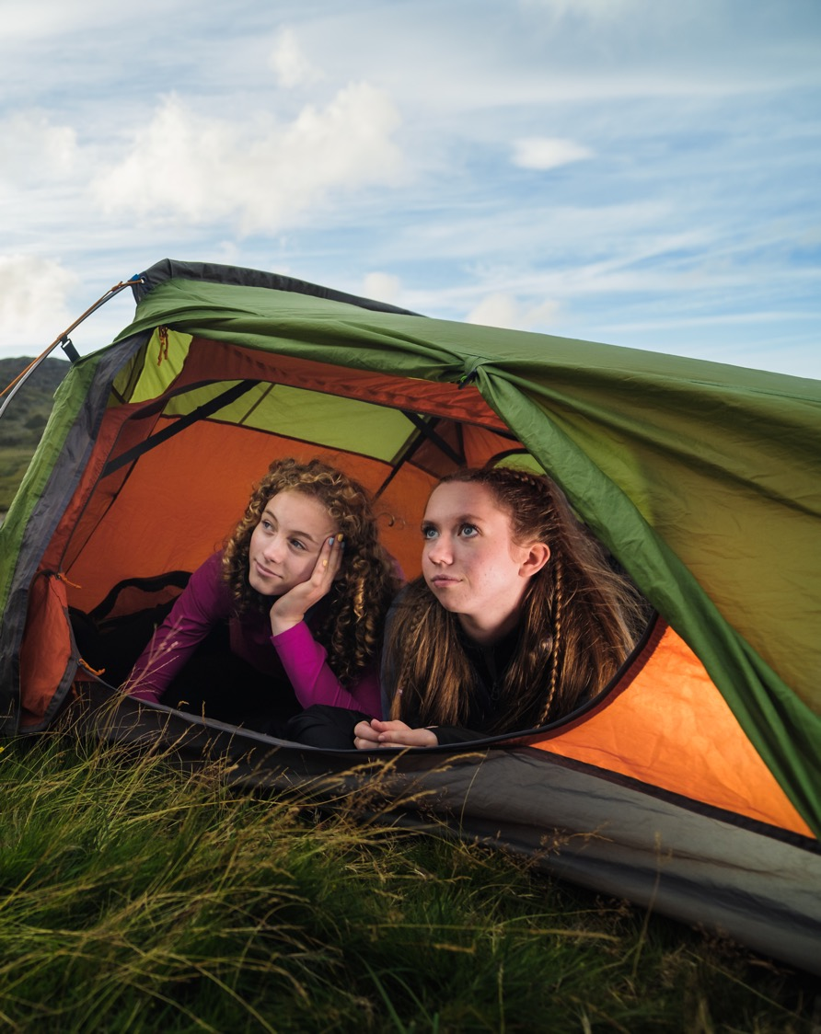
TITLE
Copy
Notes:
Why We’re Here Today​
“We’re here to understand your goals and explore how we can help your pupils thrive.”​
Frame it as a conversation, not a pitch!​
What they gain:​​
Confidence in themselves and their abilities​​
Stronger social skills and sense of belonging​​
Understanding of, and compassion for others ​​
Resilience to dig deep and keep going when things get tough​​
Awareness of the environment and the world around them​​​
​By the time they leave, they see themselves and what they’re capable of in a whole new light. ​

Slide 23
TITLE
Copy
Notes:
Why We’re Here Today​
“We’re here to understand your goals and explore how we can help your pupils thrive.”​
Frame it as a conversation, not a pitch!​
What they gain:​​
Confidence in themselves and their abilities​​
Stronger social skills and sense of belonging​​
Understanding of, and compassion for others ​​
Resilience to dig deep and keep going when things get tough​​
Awareness of the environment and the world around them​​​
​By the time they leave, they see themselves and what they’re capable of in a whole new light. ​

