Slide 1


Slide 2
HELLO!
I am John Doe
I am here because I love to give presentations.
You can find me at @username

Slide 4


Slide 6

© DISA Global Solutions All rights reserved. Do not share without explicit permission.
6

Slide 8
Email Sequence Success Rates
Email | Open Rate | Reply Rate | 1,000 Contacts
#1 Opener | 41% | 4.5% | 45 Replies
#2 Follow-up | 44% | 6.5% | 62 Replies
#3 Follow-up | 32% | 6.0% | 54 Replies
#4 Auto Email | 37% | 2.9% | 24 Replies
#5 Follow-up | 28% | 3.5% | 29 Replies
#6 Follow-up | 26% | 2.2% | 17 Replies
#7 Break-up | 36% | 4.0% | 31 Replies
Total Reply Rate Across All 7 Emails (Excludes Phone Successes) | - | 26% | 262 Replies

Slide 9
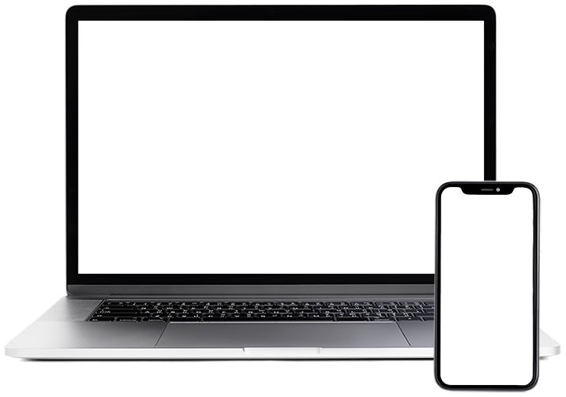
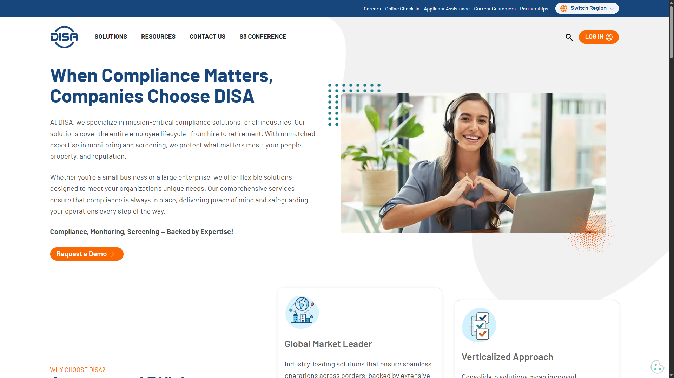

TITLE PROJECT
Show and explain your projects using this templates. Is the color of gold, butter and ripe lemons. In the spectrum of visible light, yellow is found between green and orange.
Additional text here
© DISA Global Solutions All rights reserved. Do not share without explicit permission.

Slide 13
THANKS!
Any questions?
You can find me at
@username
user@mail.me

