Slide 1

YIZKOR
Remembering Loved Ones Who Died By Suicide

Slide 2
YOU DON’T JUST LOSE SOMEONE ONCE
You lose them over and over,
Sometimes in the same day.
When the loss, momentarily forgotten,
creeps up,
and attacks you from behind.
Fresh waves of grief as the realization hits home,
they are gone.
Again.
You don’t just lose someone once,
you lose them every time you open your eyes to a new dawn,
and as you awaken,
so does your memory,
so does the jolting bolt of lightning that rips into
your heart,
they are gone.
Again.
Losing someone is a journey,
not a one-off.
There is no end to the loss,
there is only a learned skill on how to stay afloat,
when it washes over.
Be kind to those who are sailing this stormy sea,
They have a journey ahead of them,
and a daily shock to the system each time they
realize,
they are gone.
Again.
You don’t just lose someone once,
You lose them every day,
For a lifetime.
By Donna Ashworth

Slide 3
Yizkor after My Child’s Suicide
Oh grief,
How deep was her/his pain,
That my child
Could take his/her own life?
God of old,
Grant a perfect rest under your tabernacle of peace
To ______________________,
My son/daughter,
Whose life was cut off by sorrow,
By hopelessness, depression and despair,
Even in this darkness,
In this moment of inconceivable horror,
In this grief and void that seems beyond repair,
Help us to remember his/her wisdom, talents and skills,
Our times together,
Our joy, laughter and tears.
[Give me respite from this profound sense of guilt.]
In this hour of desolation,
Bring our family comfort and consolation
As we pray for him/her to find a new peace
In the world to come,
A peace he/she did not enjoy in this world.
May his / her soul be bound up in the bond of life,
A living blessing in our midst.
© 2017 CCAR Press, Alden Solovy
Yizkor after a Suicide
Oh grief,
How deep was her/his pain,
That my __________ (relationship)
Could take his/her own life?
G-d of old,
Grant a perfect rest under your tabernacle of peace
To ______________________
Whose life was cut off by sorrow,
By hopelessness, depression and despair,
In a moment of inconceivable horror.
Even in this darkness,
Even in this grief and void that seems beyond repair,
Help us to remember his/her wisdom, talents and skills,
Our times together,
Our joy, laughter and tears.
[Give me respite from this profound sense of guilt.]
In this hour of desolation,
Bring our family comfort and consolation
As we pray for him/her to find a new peace
In the world to come,
[A peace he/she did not enjoy in this world].
May his / her soul be bound up in the bond of life,
A living blessing in our midst.
© 2018 Alden Solovy and tobendlight.com.

Slide 4
In Memory of the Dead We Mourn Today
Exalted, compassionate G-d, grant perfect peace in Your sheltering presence, among the holy and the pure, whose radiance is like the heavens, to the souls of those we have recalled today.
May their memory be a blessing, and may they rest in eternal paradise.
G-d of mercy, may they find eternal shelter beneath Your sheltering wings, and may their souls be bound up in the bond of life.
May they rest in eternal peace. And let us say: Amen.

Slide 5
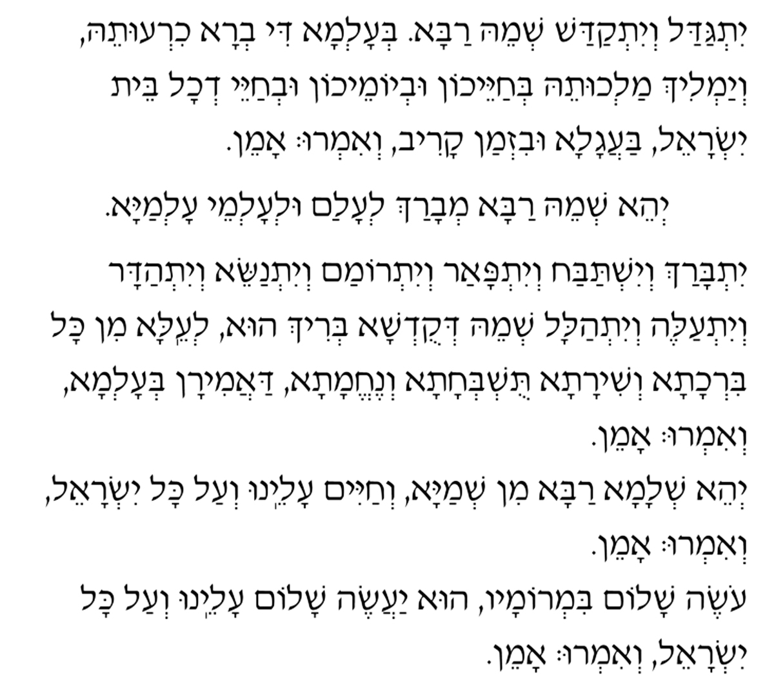
Yitgadal v’yitkadash sh’mei raba b’alma di-v’ra
chirutei, v’yamlich malchutei b’chayeichon
uvyomeichon uvchayei d’chol beit yisrael, ba’agala
uvizman kariv, v’im’ru: “amen.”
Y’hei sh’mei raba m’varach l’alam ul’almei almaya.
Yitbarach v’yishtabach, v’yitpa’ar v’yitromam
v’yitnaseh, v’yithadar v’yit’aleh v’yit’halal sh’mei
d’kud’sha, b’rich hu,
l’eila min-kol-birchata v’shirata, tushb’chata
v’nechemata da’amiran b’alma, v’im’ru: “amen.”
Y’hei shlama raba min-sh’maya v’chayim aleinu
v’al-kol-yisrael, v’im’ru: “amen.”
Oseh shalom bimromav, hu ya’aseh shalom aleinu
v’al kol-yisrael, v’imru: “amen.”

Slide 6
Season of Our Healing
This is the season of healing:
Of healing our hearts and minds,
Of healing the moments we share with each other
And the moments we share with ourselves.
This is the season of memory:
Of remembering our loved ones,
The love of generations,
The holiness of our ancestors.
This is the season of stillness,
The season of silence and quiet:
Of deep breaths,
Of open eyes,
Of compassion and consolation.
This is the season of healing:
The season of grief turning to wonder,
Of loss turning toward hope,
The season that binds this year to the next,
The season that frees this year from the next,
The season that heralds the redemption of spirit
And our return to our sacred world.
© 2017 CCAR Press from Alden Solovy

Slide 7
We Remember Them
At the rising of the sun and at its going down;
We remember them.
At the blowing of the wind and in the chill of winter;
We remember them.
At the opening of buds and in the warmth of summer;
We remember them.
At the rustling of the leaves and in the beauty of the autumn;
We remember them.
At the beginning of the year and when it ends;
We remember them.
When we are weary and in need of strength;
We remember them.
When we are lost and sick at heart;
We remember them.
When we have joys we yearn to share;
We remember them.
For as long as we live, they too will live,
for they are now a part of us
As we remember them.
By Sylvan Kamens and Rabbi Jack Riemer

